Slide 1

Cloud Readiness Assessment – Part 1
Executive Summary
April 2026
Scott Beckford
Senior Consulting Cloud Architect

Slide 2
Executive Summary

Slide 3
Objectives
Category | Details
Purpose | Assess DMG current on-premises and existing cloud environments, determine your overall cloud readiness, and recommend the most suitable public cloud platform (AWS or Azure). Scope includes reviewing infrastructure, applications, licensing, and security practices, as well as defining a high-level migration roadmap.
Key Drivers | Reduce costs - Reduce TCO with pay-as-you-go models. Control spend - Transparent monthly billing aligned with usage. Enable growth - Dynamic resource scaling to meet demand. Improve service levels - Ensure disaster recovery and high availability. Maintain security & compliance - Meet ISO 27001, SOC 2, and GDPR requirements. Enable business agility - Faster project delivery with cloud-native tools.
Selection Criteria | Economics - Total Cost of Ownership (TCO), Infrastructure Costs, Migration Costs, Software Licensing, Credits/Discounts. Security & Compliance - Certifications & Standards, Data Privacy (Sovereignty), Platform Capability, Platform Maturity. Scalability - Global Reach, Elasticity and Autoscaling, Control and Manageability. Reliability - Service Level Agreements (SLA), Data Durability, Backup and Recovery, Disaster Recovery, Track Record, Control and Manageability. Business Agility - Business Fit and Alignment, Effort to Achieve Readiness, Time To Migrate (TTM), Training and Certification.
Challenges | Limited internal cloud expertise. Complexity in Neo4j and Kafka configurations. Limited existing cloud infrastructure, no landing zones in place
Target Outcomes | Articulate DMG current cloud readiness and make recommendations to enhance readiness. Articulate DMG requirements and business drivers for migration. Estimate the cost of running DMG infrastructure in the cloud – considering future state. Assess possible future state cloud infrastructure including appropriate security services. Recommend migration approaches on a per-application basis to ensure successful cloud migration. Define appropriate Hyperscaler selection criteria and score AWS and Azure according to DMG current and desired future state.

Slide 4
Executive Summary – Cloud Recommendation
 |  | Hyperscaler Decision Matrix
Strategic Goal | Code | Value Dial | Weighting | Multiplier | AWS Score (1-5) | AWS Weighted | Azure Score (1-5) | Azure Weighted | GCP Score (1-5) | GCP Weighted
Uptime | UPT-1 | Service Level Agreements | Very High Importance | 5 | 4 | 20 | 4 | 20 | 5 | 25
 | UPT-2 | Service Credit Requirements | TBC | 0 |  | 0 |  | 0 |  | 0
 | UPT-3 | Multi-Region Resilience | TBC | 0 |  | 0 |  | 0 |  | 0
 | UPT-4 | Planned Maintenance Transparency | TBC | 0 |  | 0 |  | 0 |  | 0
 | UPT-5 | Dependency Resilience | TBC | 0 |  | 0 |  | 0 |  | 0
Reliability | REL-1 | Data Durability | TBC | 0 |  | 0 |  | 0 |  | 0
 | REL-2 | Backup and Recovery | TBC | 0 |  | 0 |  | 0 |  | 0
 | REL-3 | Historical Service Stability Record | TBC | 0 |  | 0 |  | 0 |  | 0
Scalability | SCL-1 | Elastic Demand Variability | TBC | 0 |  | 0 |  | 0 |  | 0
 | SCL-2 | Global Expansion Readiness | TBC | 0 |  | 0 |  | 0 |  | 0
 | SCL-3 | Data Scale Growth Curve | TBC | 0 |  | 0 |  | 0 |  | 0
 | SCL-4 | Platform Service Limits | TBC | 0 |  | 0 |  | 0 |  | 0
Security | SEC-1 | Regulatory Compliance Alignment | TBC | 0 |  | 0 |  | 0 |  | 0
 | SEC-2 | Identity & Access Maturity | TBC | 0 |  | 0 |  | 0 |  | 0
 | SEC-3 | Encryption & Key Sovereignty | TBC | 0 |  | 0 |  | 0 |  | 0
 | SEC-4 | Threat Detection & SOC Integration | TBC | 0 |  | 0 |  | 0 |  | 0
 | SEC-5 | Provider Security Capability | TBC | 0 |  | 0 |  | 0 |  | 0
Performance | PERF-1 | Latency Sensitivity | TBC | 0 |  | 0 |  | 0 |  | 0
 | PERF-2 | HPC / Specialized Compute | TBC | 0 |  | 0 |  | 0 |  | 0
 | PERF-3 | Storage Throughput | TBC | 0 |  | 0 |  | 0 |  | 0
 | PERF-4 | Network Backbone Quality | TBC | 0 |  | 0 |  | 0 |  | 0
Business Analytics | BA-1 | Native Data Platform Integration | TBC | 0 |  | 0 |  | 0 |  | 0
 | BA-2 | AI/ML Service Maturity | TBC | 0 |  | 0 |  | 0 |  | 0
 | BA-3 | Real-Time Analytics | TBC | 0 |  | 0 |  | 0 |  | 0
 | BA-4 | Data Governance Tooling | TBC | 0 |  | 0 |  | 0 |  | 0
Transparency | TRN-1 | Roadmap Visibility | TBC | 0 |  | 0 |  | 0 |  | 0
 | TRN-2 | Incident Reporting Detail | TBC | 0 |  | 0 |  | 0 |  | 0
 | TRN-3 | Billing Granularity | TBC | 0 |  | 0 |  | 0 |  | 0
Cost | CST-1 | TCO | TBC | 0 |  | 0 |  | 0 |  | 0
 | CST-2 | Predictability vs Elasticity | TBC | 0 |  | 0 |  | 0 |  | 0
 | CST-3 | Egress Sensitivity | TBC | 0 |  | 0 |  | 0 |  | 0
 | CST-4 | Discount Programs | TBC | 0 |  | 0 |  | 0 |  | 0
 | CST-5 | Migration Costs | TBC | 0 |  | 0 |  | 0 |  | 0
 | CST-6 | FinOps Tooling | TBC | 0 |  | 0 |  | 0 |  | 0
Sovereignty | SOV-1 | Data Residency Requirements | TBC | 0 |  | 0 |  | 0 |  | 0
 | SOV-2 | Operational Sovereignty | TBC | 0 |  | 0 |  | 0 |  | 0
 | SOV-3 | Legal Jurisdiction Exposure | TBC | 0 |  | 0 |  | 0 |  | 0
Business Fit | FIT-1 | Existing Ecosystem Alignment | TBC | 0 |  | 0 |  | 0 |  | 0
 | FIT-2 | Toolchain Alignment | TBC | 0 |  | 0 |  | 0 |  | 0
 | FIT-3 | 3rd Party Integration | TBC | 0 |  | 0 |  | 0 |  | 0
 | FIT-4 | Industry Regulatory Maturity | TBC | 0 |  | 0 |  | 0 |  | 0
 | FIT-5 | Partner & Talent Availability | TBC | 0 |  | 0 |  | 0 |  | 0
 | FIT-6 | Executive Relationship & Strategic Alignment | TBC | 0 |  | 0 |  | 0 |  | 0
 | FIT-7 | Organizational Skill Alignment | TBC | 0 |  | 0 |  | 0 |  | 0
 | FIT-8 | Day 0,1,2 Operations | TBC | 0 |  | 0 |  | 0 |  | 0
 | FIT-9 | Target Operating Model | TBC | 0 |  | 0 |  | 0 |  | 0
Sustainability | SUS-1 | Carbon Neutral Commitments | TBC | 0 |  | 0 |  | 0 |  | 0
 | SUS-2 | Energy Transparency | TBC | 0 |  | 0 |  | 0 |  | 0
 | SUS-3 | Renewable Energy Sourcing | TBC | 0 |  | 0 |  | 0 |  | 0
Licensing | LIC-1 | BYOL Flexibility | TBC | 0 |  | 0 |  | 0 |  | 0
 | LIC-2 | Hybrid Licensing Benefits | TBC | 0 |  | 0 |  | 0 |  | 0
 | LIC-3 | Marketplace Procurement | TBC | 0 |  | 0 |  | 0 |  | 0
Velocity | VEL-1 | DevOps Toolchain Integration | TBC | 0 |  | 0 |  | 0 |  | 0
 | VEL-2 | Infrastructure as Code Maturity | TBC | 0 |  | 0 |  | 0 |  | 0
 | VEL-3 | Managed Service Abstraction | TBC | 0 |  | 0 |  | 0 |  | 0
 | VEL-4 | Time-to-Prototype | TBC | 0 |  | 0 |  | 0 |  | 0
 | VEL-5 | AI Tooling Integration | TBC | 0 |  | 0 |  | 0 |  | 0
TOTAL |  |  |  |  |  | 20 |  | 20 |  | 25
The weighted scoring shows a preference for: CLOUD1
Scoring was assessed across 5 Strategic Goal Categories specific to DMG requirements
Any of the three providers could ably support DMG’s infrastructure, application, security, and business needs.

Slide 5
Executive Summary – Findings, Conclusion & Next Steps
Category | Details
Findings | Assessed 2 datacentres (Prod/Staging and Dev/Test/QA) and existing AWS and Azure footprint. From 182 Virtual Servers initially discovered in the DMG datacentres (DCC/LPC) and GoSupply, agreed 158 Virtual Servers in scope for migration with relatively even split between Windows & Linux. From 32 applications discovered agreed 29 in scope for migration - DMG as priority app will be a greenfield migration approach while non-prod and less critical systems will be image migrations. Identified key areas for cloud-maturity building including training, cloud-centre of excellence and exploiting cloud-native tooling.
Conclusion | Close Capability Match - Both hyperscalers offer robust feature sets for migration of DMG workloads including DMG key requirements. To minimise risk during the cutover, DMG would benefit from building new servers and cutting over (Greenfield migration approach) rather than replicating existing Virtual Servers into the cloud (image-based migration approach). Phased approach - Move Production first, followed by Staging, in sync with upcoming data center exit timelines (Prod May 25, Dev/Test Oct 25). Platform Choice – AWS and Azure are both able to meet DMG key requirements and score incredibly closely based on the agreed criteria and weighting, considering key requirements. GoSupply being hosted in Azure already means Azure is a simpler transition than AWS. Rackspace suggest considering additional strategic criteria based on future requirements, and reviewing the weighting of existing criteria as this could tip the balance.
Next Steps | DMG confirm final Hyperscaler decision – adding additional selection criteria or re-allocating weighting to existing criteria. Rackspace to present migration effort estimates and commercials. Rackspace to present managed services offerings and commercials. DMG Review Migration Readiness Assessment recommendations and consider cloud maturity action plan. Move forward with DMG migration to chosen Hyperscaler.

Slide 6
Project Introduction

Slide 7
Project Stakeholders
DMG
Full Name | Role
Neil Finlayson | Chief Technical Officer (DMG Executive Sponsor)
Tristan Newton | Head of Infrastructure & Security
Carl Jessop | Director of Support Services
Alison Witt | Director of Support Services
Mark Sawyer | Director of Information Security
Mark Hattersley | Director of Web and Performance Services
Chris Dalton | Director of Infrastructure Services
Rackspace
Full Name | Role
Nick Kuhle | UK Sales Director
Vikram Somani | Account Director
Keiran Holloway | Practice Lead
Matthew Wright | Senior Programme Manager
Scott Beckford | Lead Solution Architect
Rishabh Dogra | GCP Architect
Upendra Kumar | Azure Architect
Akashdeep Singh | AWS Architect
Alejandro Young | Cloud Engineer
Gopiramesh Palanisamy | Migration Consultant

Slide 8
Project Aims and Objectives
Item | Details
Assess Current Infrastructure | Evaluate DMG existing data centres in Reading and Slough for technical readiness and compatibility with public cloud.
TCO Analysis | Independent Comparison of Total Cost of Ownership across 3 major hyperscalers
Determine Cloud Readiness | Assess DMG ability to adopt public cloud services based on the six perspectives of the Cloud Adoption Framework – Business, People, Governance, Platform, Security, Operations.
Hyperscaler Selection | Compare AWS and Azure to identify the optimal platform based on cost, capabilities, and alignment with business needs.
Roadmap Development | Outline actionable next steps and a high-level plan to guide the journey from assessment to successful cloud adoption.

Slide 9
Business Drivers

Slide 10
Cloud Migration Business Drivers - Summary
1. Standardisation + Simplification
Reduce complexity to scale operations and delivery speed
2. Productivity + Cost Optimisation
Remove low value work and create credible savings
3. Automation + Workflow Optimisation
Reduce toil and improve customer experience
NB: Enhanced Security & Data/AI analytical insights are an expected outcome of transformation, not necessarily a pure business driver.

Slide 11
Standardisation + Simplification
Driver # 1
Goal
Standardisation of Core Technology products across DMG Business
Meet North Star growth targets across all brands
MOL – 1M Subscribers
Eliminate Shadow IT
Strategic Intent
Standardisation is a prerequisite for scalable growth
Platform sprawl increases cost, risk, and execution friction
Converge on a limited set of approved platforms and architectural patterns
Enforce security, compliance, and governance by design
Preserve innovation while eliminating unnecessary variation
Outcome
Simplified Target Operating Model (TOM)
Lower execution and operational risk
Faster, more predictable delivery of change
A scalable foundation that supports growth without proportional complexity
Reduce complexity to scale operations and delivery speed

Slide 12
Productivity + Cost Optimisation
Driver # 2
Goal
Removal of custom systems and processes providing low value
Replacement with pre-approved blueprints/templates
Reduce total cost of ownership while improving delivery velocity
Shift from fixed, capacity‑based cost models to demand‑aligned consumption
Strategic Intent
Translate cloud adoption into financial performance
Cloud only delivers value with active cost discipline
Inefficiency compounds rapidly at scale
Embed financial accountability into technology decision‑making
Outcome
Measurable cost optimisation and improved margin predictability
Clear visibility of spend by platform, product, and environment
Financial governance (FinOps) embedded into the operating model
Remove low value work and create credible savings

Slide 13
Automation + Workflow Optimisation
Driver # 3
Goal
Automate repeatable, high‑volume operational workflows
Adopt Self-service delivery model to improve customer service levels
Strategic intent
Manual processes limit growth and degrade customer experience
Automation is essential for enterprise‑scale cloud operations
Improve service consistency, resilience, and customer experience
Default to cloud‑native and managed services where appropriate
Outcome
Reduced operational and key‑person risk
Ability to scale revenue without linear cost growth
Business teams focused on value creation rather than administration
Reduce toil and improve customer experience

Slide 14



Driver 1: Standardization
Standardization
• Platform sprawl increases cost, risk, and execution friction
• Standardization is a prerequisite for scalable growth
Strategic Intent
• Converge on a limited set of approved platforms and architectural patterns
• Enforce security, compliance, and governance by design
• Preserve innovation while eliminating unnecessary variation
Outcome
• Lower execution and operational risk
• Faster, more predictable delivery of change
• A scalable foundation that supports growth without proportional complexity
Business Drivers
Reduce variation to scale operations and delivery speed

Slide 15

Driver 2: Cost and productivity
Translate cloud adoption into financial performance
• Cloud only delivers value with active cost discipline
• Inefficiency compounds rapidly at scale
Strategic Intent
• Reduce total cost of ownership while improving delivery velocity
• Shift from fixed, capacity‑based cost models to demand‑aligned consumption
• Embed financial accountability into technology decision‑making
Outcome
• Measurable cost optimisation and improved margin predictability
• Clear visibility of spend by platform, product, and environment
• Financial governance (FinOps) embedded into the operating model
Business Drivers
Remove low value work and create credible savings

Slide 16

Driver 3: Automation
Business Drivers
Scale operations without scaling cost or risk
• Manual processes limit growth and degrade customer experience
• Automation is essential for enterprise‑scale cloud operations
Strategic intent
• Automate repeatable, high‑volume operational workflows
• Improve service consistency, resilience, and customer experience
• Default to cloud‑native and managed services where appropriate
Outcome
• Reduced operational and key‑person risk
• Ability to scale revenue without linear cost growth
• Teams focused on value creation rather than administration
Reduce toil and improve customer experience

Slide 17
Project Scope
DATACENTERS
3
SERVERS
3038
CLOUD
ACCOUNTS
APPLICATIONS +
SERVICES
39
DATABASE
SERVERS
88
(74/182 total Virtual Servers)
RDG SLO SYD
AWS Azure GCP
Have we defined our platform and infrastructure strategy?
How will our hardware and servers evolve during our cloud transformation journey?
What is our approach to server migration, and how will our servers evolve during our cloud transformation journey?
Have we established a presence in the cloud?
How will our cloud footprint evolve during our transformation journey?
What is our approach to application migration, and how will our applications evolve during our cloud transformation journey?
What is our approach to database migration, and how will our databases evolve during our cloud transformation journey?

Slide 18
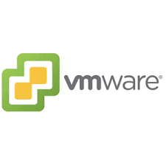
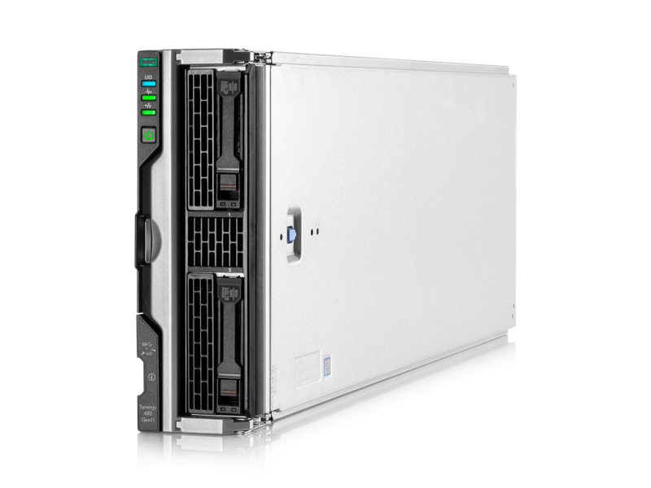
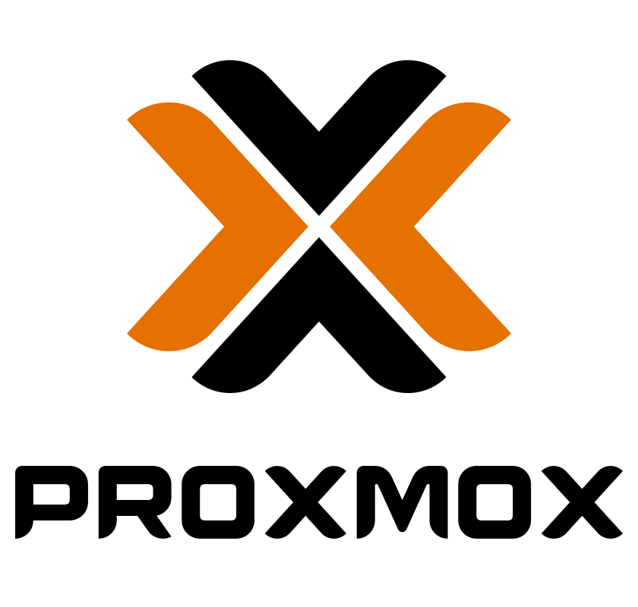
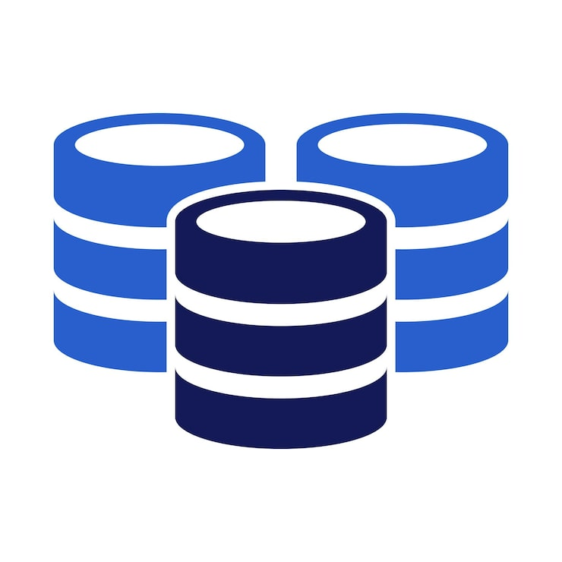
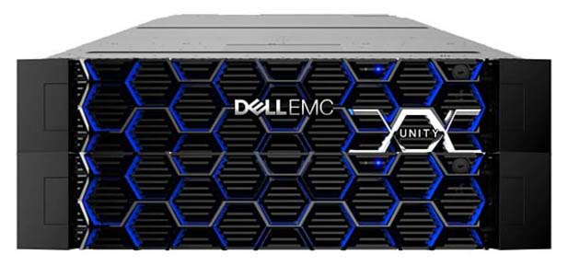
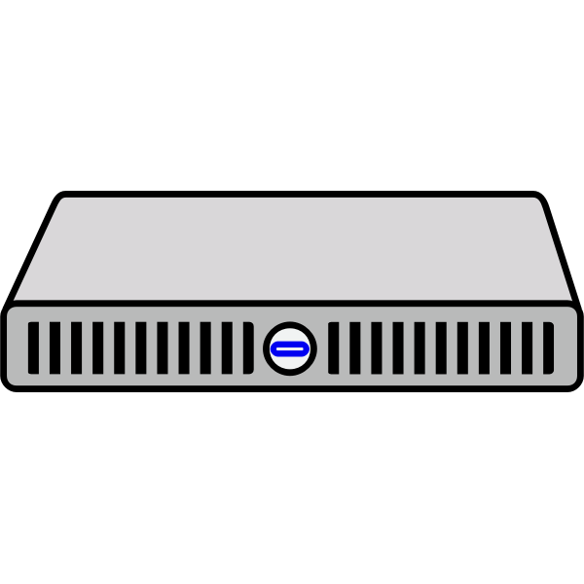
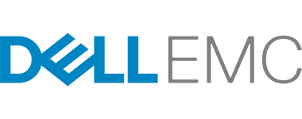


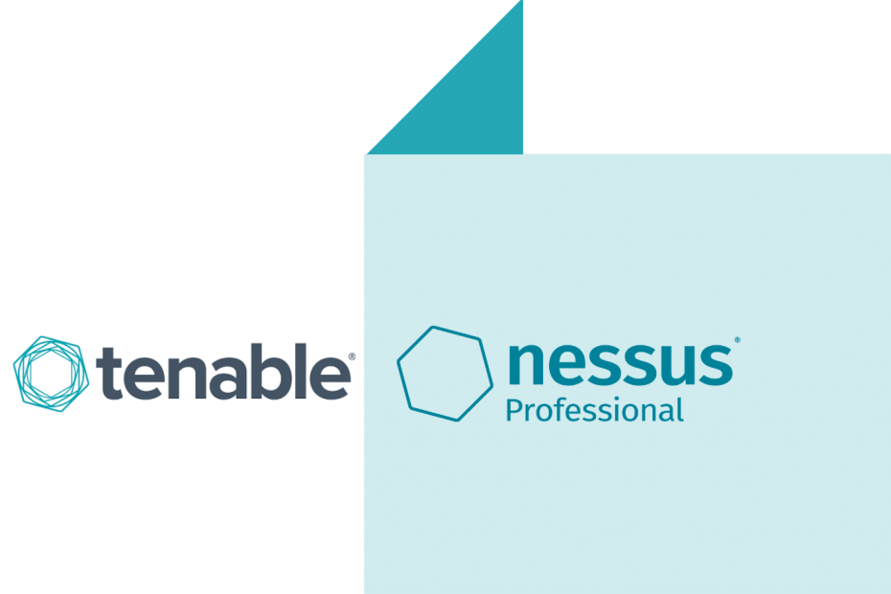
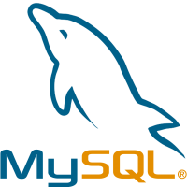
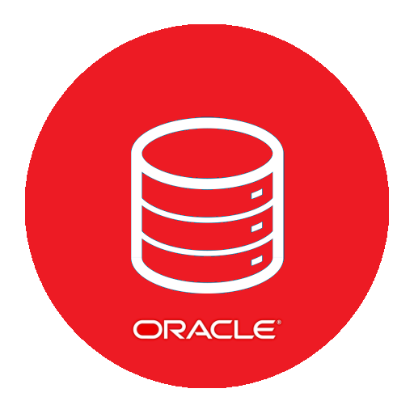
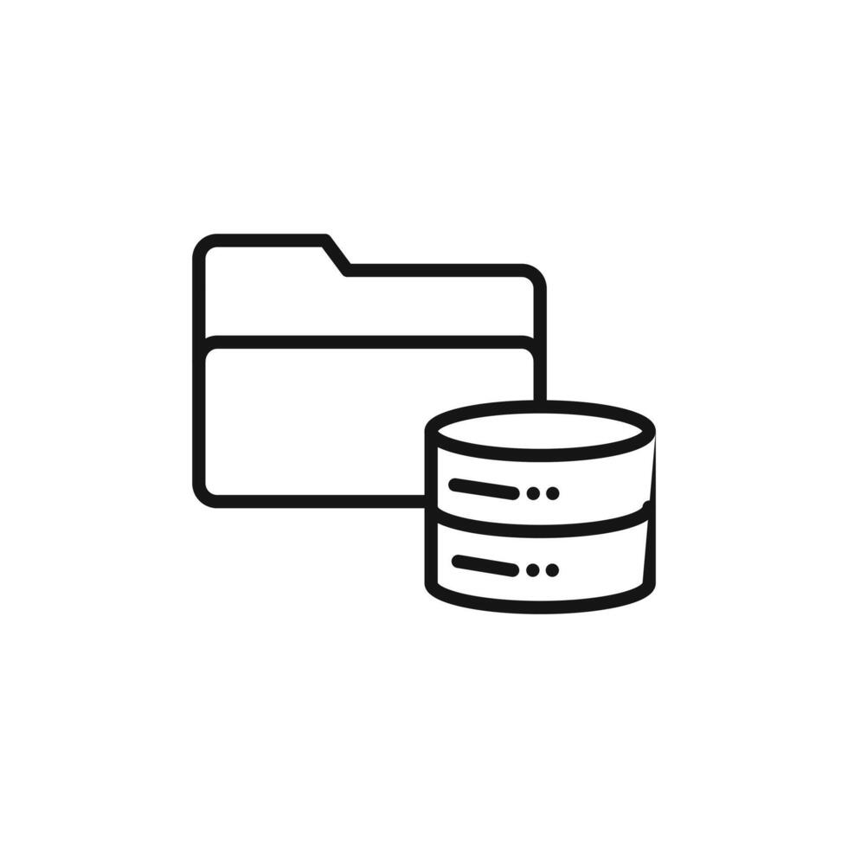

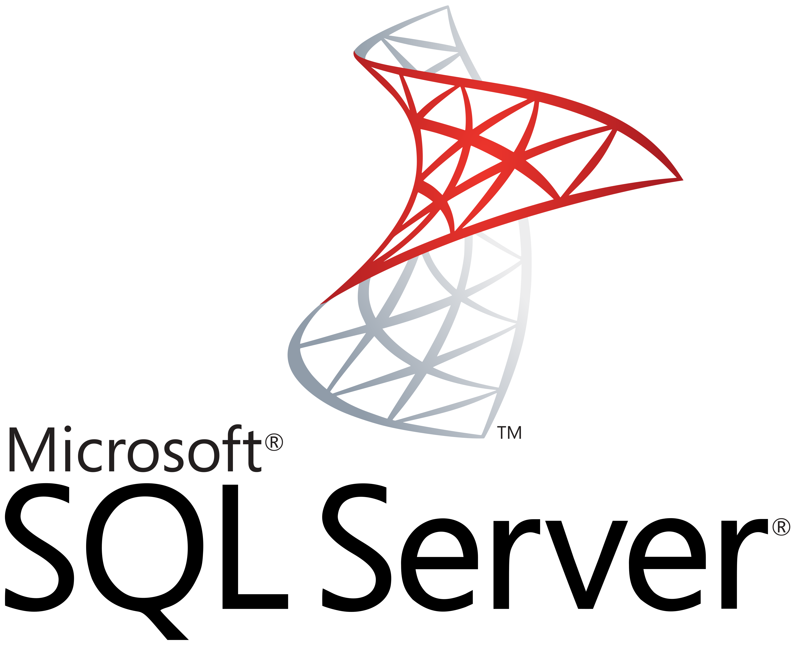

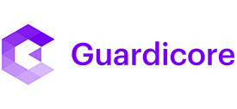

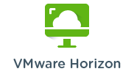

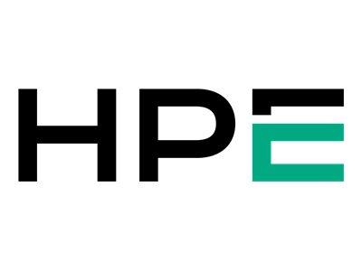

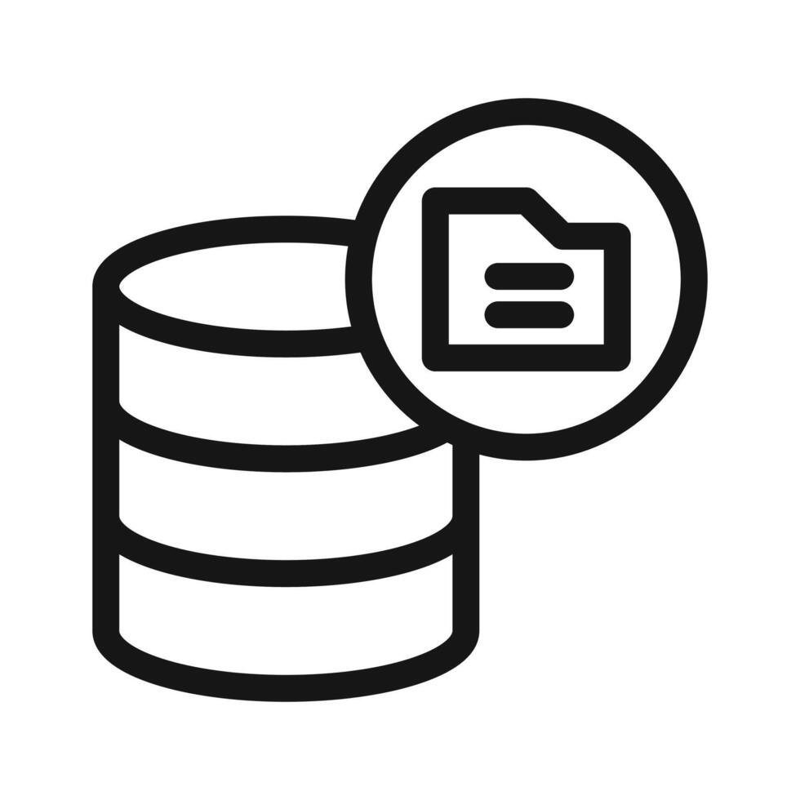
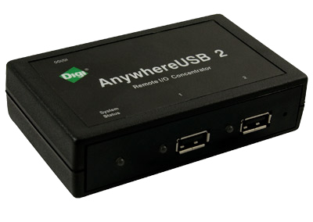
DMG Inventory Scope – At a Glance
Physical Appliances?
Virtual Appliances
Virtual DBServers
SAN Storage
DBs on Physicals
Reading
MOL - Prod
6 x DL360
6 x 3par
6 x HPE 480 G11
4x
3x
No MOL proxmox
In Reading
6 x Reading - prod
???
5x
2x
CHP – Prod
1 x DL360
1 x Primera
???
ANL proxmox
Reading – TEST ONLY
2x
CHP
???
4x
9x
Atex – Prod
1 x DL380
1 x Primera
Slough
MOL - Prod + Int
8 x DL360
8 x 3par
3x
MOL INT :51 Linux
6x
???
CHP - Prod + Int
2 x DL360
2 x Primera
3 x Slough - non-prod
3 x Slough - prod
8x
???
ECO3 Courier
Atex – Prod
2 x DL380
2 x Primera
3x
4x
12x
Anywhere USB
Sydney
29x
4x
38x
3x
2x
38x
=========
3076 Assets

Slide 19
Requirements

Slide 20
Organisation Profile
Organisation Name | DMG Media
Organisation Owner | DMGT (Daily Mail and General Trust PLC)
Organisation Type / Date | Private Limited Company (founded 1922)
Organisation Industry | Media
Organisation Size | 4000 Employees
Organisation Headquarters | Kensington, London, England
Organisation Markets | Worldwide
Organisation Website | https://www.dmgmedia.co.uk/

Slide 21

Organisation Profile
Organisation Name | Achilles Information Limited
Organisation Owner | Bridgepoint Development Capital (“BDC”)
Organisation Type / Date | Private limited Company (founded in 1991)
Organisation Industry | Business Intelligence Platforms
Organisation Size | Between 500 and 1,000 Employees
Organisation Headquarters | Abingdon, Oxfordshire, England
Organisation Markets | Worldwide
Organisation Website | https://www.achilles.com

Slide 22
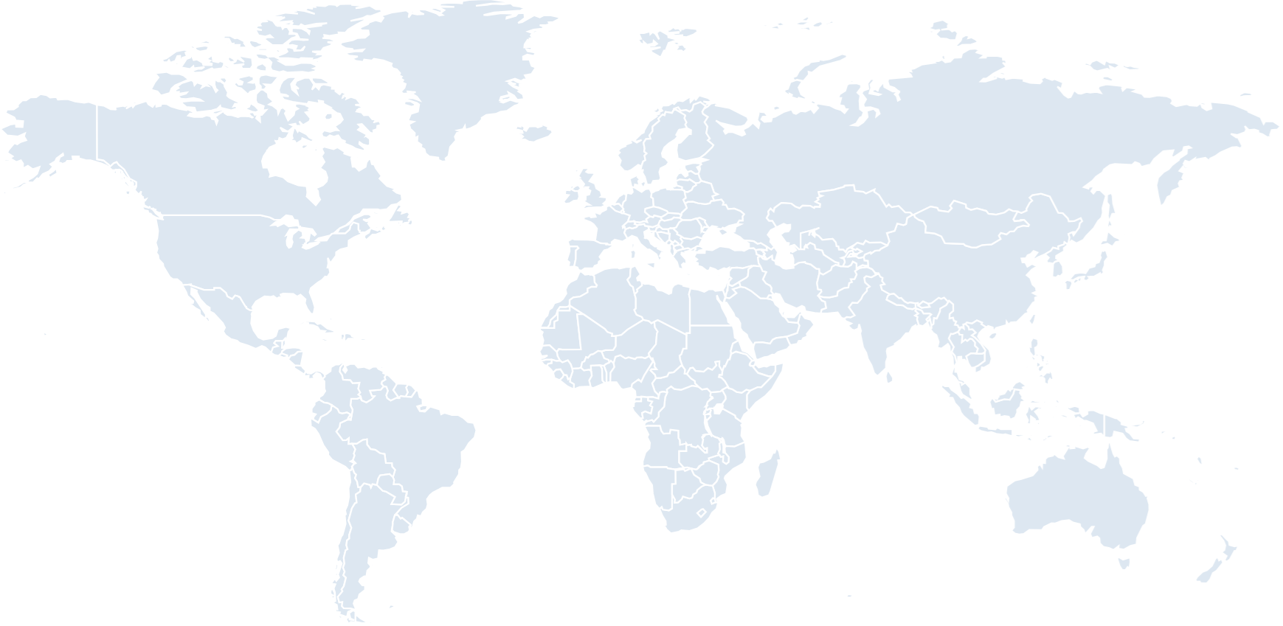

Organisation Global Presence
Carn, Glasgow
Dublin
Leicester, Manchester
London - Reading
London - Slough
Los Angeles
New York
In Scope
Out of Scope
Sydney
Notes:
Leceister, Manchester

Slide 23
Organisation Global Presence
Aberdeen
Arendal
Dublin
Abingdon
Frankfurt
Irvine CA (GRMS)
Madrid
Houston
Hong Kong
Mexico City
Riyadh
Mumbai
Bogotá
Lima
Rio de Janeiro
Santiago
Buenos Aires
Sydney

Slide 24
CRA Project Approach

Slide 25
Project Methodology – Part 1
Phase 1
Mobilisation & Kick Off
Workstream | Activity detail | Key Outputs
 | Kick off meeting Stakeholder mapping / Communication Planning Provision of access | Mutually agreed high-level project plan Communication plan
 | Conduct foundational workshops with Customer stakeholders Understand & document business change drivers, future business plans, roadmaps & customer strategy Finalise the Hyper-scaler selection criteria/evaluation parameters | Foundational workshops with Customer stakeholders Requirements summary Hyper-scaler selection criteria
 | Assist in deploying and configuring hyper–scaler tooling in DMG environments to generate discovery data Identify the existing infrastructure in the environment, including software and networking Evaluate the compatibility of existing infrastructure with Microsoft Azure/AWS/GCP tooling Determine the current capacity and utilisation of the infrastructure Assess the Backup requirements including lifecycle and retention policies Assess the business requirements and expected workload for the future Licensing, IP address conflicts, network security policies, or DNS configurations Document & understand the network connectivity on existing environment | Infrastructure Discovery Report with detailed asset inventory and configuration analysis Application-to-Infrastructure mapping Application-to-Database mapping Application high-availability (HA) mapping Network dependency mapping Application & Infrastructure mapping
 | Total Cost of Ownership analysis for cloud migration | Total Cost of Ownership Analysis for the 3 Hyper-scalers 1-year financial projections and cost optimisation recommendations
 | AWS vs Azure vs GCP cloud - comparative analysis Scoring of the Hyper-scaler across the mutually agreed parameters Selection of preferred cloud platform | Cloud Service Provider Evaluation Matrix with detailed comparison and selection criteria Recommendation of cloud platform
 | Creation of strategy report, including: Hyper-scaler recommendation TCO analysis Cloud maturity level and gap analysis Infrastructure assessment Presentation of Strategy & recommendations to the Customer | Executive Summary Report and Strategic Presentation with actionable recommendations and business case
Phase 2
Strategy Assessment
Phase 3
Automated Infrastructure Discovery
Phase 4
TCO Analysis
Phase 5
Cloud Service Provider Selection
Phase 6
Cloud Strategy Report & Presentation
Notes:
Current state workshop
Risk & Motivation workshop
Migration Readiness Assessment questionnaire

Slide 26
Cloud Readiness Assessment - Part 1 - Plan on a Page
w/c 09-Feb
w/c 16-Feb
w/c 23-Feb
w/c 2-Mar
w/c 9-Mar
w/c 16-Mar
w/c 23-Mar
w/c 30-Mar
w/c 6-Apr
w/c 13-Apr
w/c 20-Apr
w/c 27-Apr
Phase 1
Mobilisation & Kick Off
Kick off
Project Plan Agreed
Project Closure
Phase 2
Strategy Assessment
Foundational Workshops
Selection Criteria Agreed
Phase 3
Automated Infrastructure Discovery
Discovery tooling install
Discovery data collection
Data Filter + Export
Phase 4
TCO Analysis
TCO Analysis
Phase 5
Cloud Service Provider Selection &
Cloud Comparison Analysis
Phase 6
Cloud Strategy Report & Presentation
Cloud Readiness Assessment
Cloud Strategy Report
Playback

Slide 27
Key Assumptions – Achilles Datacentres
Category | Title | Detail
Assumption | Cloud Economics - | Compute & Licensing costs for AWS & Azure includes Operating System and Microsoft SQL DB license cost as well. Rationale was to closely align AWS with Azure from license costs point of view. Licenses cannot be transferred to the cloud for Microsoft / Linux OS as they are procured by Colt.
Assumption | Cloud Economics | Network costs is assumed to be 5% of the Compute and Storage costs in line with typical costs we see in this space.
Assumption | Cloud Economics | Backup costs includes Backup costs of 95 TB data with 10% yearly growth and 0.5% daily data change rate. Retention Period: Daily - 7days / Weekly - 4 weeks / Monthly - 12 Months. Rationale was to align how AWS & Azure calculate the backup costs.
Assumption | Cloud Economics | Enterprise Support plan was assumed for Azure, while AWS MPA recommended Business Support Plan.
Assumption | Cloud Economics (TCO) | Azure hybrid benefits are not been enabled for Windows and SQL server.

Slide 28
Key Assumptions - GoSupply
Category | Title | Detail
Assumption | Cloud Economics (TCO) | GoSupply costs are calculated from the monthly cost figures and existing resource export provided, no agents were installed in the Azure environment itself.
Assumption | Cloud Economics (TCO) | Based on GoSupply Inventory shared: 9 x Virtual Servers are running Microsoft SQL Server 2019 Standard Edition is assumed as specific SQL DB Engine version and Edition was not stated in the GoSupply inventory.
Assumption | Cloud Economics (TCO) | Based on GoSupply Inventory shared: 9 x Virtual Servers are running Microsoft SQL Server 2019 Standard Edition is assumed as specific SQL DB Engine version and Edition was not stated in the GoSupply inventory.
Assumption | Cloud Economics (TCO) | All the GoSupply Virtual Servers (17+9=26) Virtual Servers are using 500GB storage per Virtual Server, as there was no information about Disk sizes in the inventory shared by GoSupply.
Assumption | Cloud Economics (TCO) | 9 x GoSupply Virtual Servers meant for SQL Database are using 4 vCPUs with 16 GB RAM per Virtual Server
Assumption | Cloud Economics (TCO) | All 26 Virtual Servers are utilizing 100% CPU & RAM
Assumption | Cloud Economics (TCO) | TCO for GoSupply does not include cost for other in use Azure services E.g. Azure DataFactory, Azure Cosmos DB, Azure DevOps etc.

Slide 29
Key Constraints and Decisions
Category | Title | Detail
Decision | Infrastructure Assessment | Telstra & Spain data centres are excluded from scope.
Decision | Infrastructure Assessment | The existing AWS DR environments backup and recovery will be addressed in subsequent Landing Zone design and build phases of Achilles’ cloud migration.
Decision | Organisation Assessment | Achilles will not share details of employee qualifications / experience in cloud platforms therefore Rackspace are, for hyperscaler selection purposes, to treat the team as having no prior cloud experience.
Constraint | Cloud Economics (TCO) | Achilles declined to share labour, services and support costs therefore these are excluded from all cost estimates / total cost of ownership comparisons.
Constraint | Infrastructure Assessment | AWS / Azure account access was not provided so assessment was all via screenshare.
Constraint | Infrastructure Assessment | Conversations to confirm Virtual Server scope still ongoing in January 2025 – but time required to conduct cost estimations means that information as of early December 2024 had to be used.

Slide 30
CRA Infrastructure Analysis

Slide 31
Infrastructure Discovery
Tools Used
Information Captured
Challenges
Manual discovery performed for:
AWS Application Discovery (Agent based)
Azure Migrate (Agentless)
Discovery workshops with Achilles’ technical team
Compute (CPU & Memory Avg. and Peak)
Data (Network, Disk & DB)
182 servers have been considered for high level analysis –refined to 158 in the cost analysis after de-scope decisions made by Achilles
Licensing
Network devices
Storage (SAN/NAS)
3rd party App/DB
Discovery Duration
Outputs
Restrictions
2 weeks
AWS MPA report (Excel)
Azure Migrate (PDF)
Limited direct access to Achilles’ AWS & Azure accounts to conduct discovery

Slide 32
Discovery / Virtual Servers
Virtual Servers
Operating Systems
Infrastructure
3034
Virtual Servers identified as potential candidates for a cloud migration initiative.
Platforms
*Operating System details for GoSupply are assumed as: 25x Windows Server 2019 Standard & 1x RHEL 7.9

Slide 33
Discovery / Databases
Database Virtual Servers
DB Engine/Editions
DB Ownership
74
Database Virtual servers identified as potential candidates for a cloud migration initiative (within the 182 total virtual servers in scope).
Discovery tooling used to identify Microsoft SQL Server except GoSupply, all other Database variants identified using manual discovery and stakeholder interview.

Slide 34
Discovery / Applications
Data Source
App Type
Applications
32
Business applications and services identified as potential candidates for a cloud migration initiative.
Internal vs External facing
Criticality

Slide 35
CRA Infrastructure Insights

Slide 36
Datacentre Infrastructure Insights (excluding GoSupply)
Allocated Storage
Peak Avg. CPU Utilization
113 TB
86%
Virtual Server Utilization
Storage Usage
Peak Avg. RAM Utilization
71 TB
69%
156
Unused Storage
42 TB 20 TB over provisioning. Industry standard is additional 20-30% of used storage.
As per industry standard:
Optimal: CPU or Memory usage < 21% and > 70%
Over: CPU or Memory usage <70%
Idle: CPU or Memory usage < 20%

Slide 37


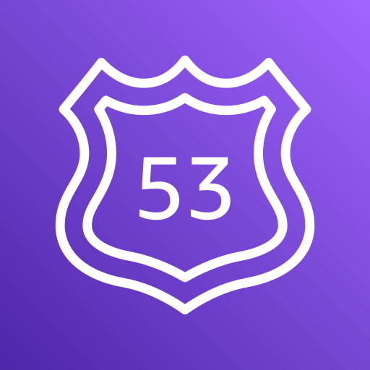
AWS Infrastructure Insights
AWS Transfer Family service is used for SFTP with backend AWS S3.
sftp.achilles.com endpoint is used by MyAchilles application to fetch files over the Internet.
13 SFTP Users with Data Size less than 3GB.
SSH Keys are used for Authentication by users.
SSH Keys are not rotated regularly.
ATF SFTP
S3 is used a backend storage for sftp.achilles.com ATF endpoint.
3 x Additional buckets meant for ESPD to store historic data from Confluent Cloud Elasticsearch.
Some other buckets which are not in use anymore E.g., s3-titan-ses-reports.
S3
Route53 hosts “achillesedge.com” Public Hosted DNS Zone.
Route53 is used for Blue/Green/Maintenance deployments of application by changing DNS record weights.
Route53 DNS record weights are updated using Terraform.
Route 53

Slide 38
AWS Infrastructure Insights / Recommendations
Achilles should rotate the SSH keys on regular intervals at least every 180 days.
“sftp.achilles.com” can be migrated to Azure Blob storage using SFTP endpoint in Azure.
If the components need to be migrated to Azure, S3 objects can be migrated to Azure Blob storage.
Route53 Public Hosted Zone can be migrated to Azure DNS.
Alternatively, Achilles can adopt “Retain” approach to stay with AWS.

Slide 39
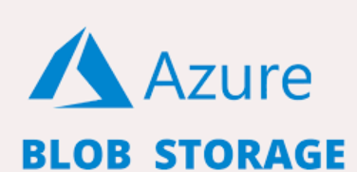

Azure Infrastructure Insights (GoSupply & Achilles)
Azure blob storage is used for storing data for backup and restore, and archiving.
It is also been used for Storing files for distributed access.
Azure Key Vault is used to Securely store and tightly control access to tokens, passwords, certificates, API keys, and other secrets.
Authentication is done via Microsoft Entra ID. Authorization may be done via Azure role-based access control (Azure RBAC) or Key Vault access policy. Azure RBAC can be used for both management of the vaults and to access data stored in a vault, while key vault access policy can only be used when attempting to access data stored in a vault.
Achilles’ also deliver B2C authentication through an existing Azure account.

Slide 40
Azure Infrastructure Insights / Recommendations
For vulnerabilities and patching Achilles’ could utilize Azure update manager services to improve their security posture.
“sftp.achilles.com” can be migrated to Azure Blob storage using SFTP endpoint in Azure if Azure is the chosen Hyperscaler.
If GoSupply is retained on Azure, Rackspace would recommend utilising a sub-management group with standard Azure policy / security compliance enabled to remediate open issues.
In this case, the resources would be moved from one subscription to a new subscription utilizing the existing Azure services so major redesign and replatforming would not be required.
Critical hyperscaler selection dependency – if AWS is selected as target cloud
If GoSupply has to move to AWS, significant effort would be required to re-platform the services to AWS and this would come with a large up-front assessment and design effort.

Slide 41
Disaster Recovery Insights
Findings
Achilles currently has a Disaster Recovery setup in an AWS environment.
For DB, DB native replication technology are in use for Microsoft SQL & Neo4j.
For Windows File Server, DFS-R (Distributed File System Replication) is in use.
High-level Recommendations
Rackspace recommendation would be to use the native replication technologies where possible (E.g. At DB or File level).
For servers which do not have native replication technologies (E.g. Web/Middleware) create/copy Virtual Servers templates in DR region and build Virtual Servers using IaC during DR/DR Test.
In addition to above, Clone/Copy backup to an alternative region as a secondary option to recover services using backup & restore option.
Both hyperscalers have their own DR services offering which will be explored during the design phase.

Slide 42
Licensing Insights

Slide 43
Insights / Licensing Operating Systems (Microsoft)
Microsoft Operating Systems | End of Support (EOS)
Version | Virtual Servers | EOS (Date) | EOS (Days) | Risk | % of Estate
Windows Server 2012 | 8 | 10/10/2023 | (-) 464 | High
Windows Server 2016 | 30 | 01/12/2027 | (+) 726 | Medium
Windows Server 2019 | 67 | 01/09/2029 | (+) 1454 | Low
Overall, from Windows Operating System point of view there are no major risks discovered except Windows Server 2012 being EOL - however on further analysis this is limited to RQM / LATAM Virtual Servers which are not in scope for migration. It is understood extended support is in place.
*GoSupply on Azure figures are a high-level assessment

Slide 44
Insights / Licensing Operating Systems (Linux)
Linux Operating Systems | End of Maintenance (EOM)
Version | Virtual Servers | EOM (Date) | EOM (Days) | Risk | % of Estate
RedHat Ent. Linux 7.9 | 64 | 30/06/2024 | (-) 200 | High
RedHat Ent. Linux 8.10 | 10 | 31/05/2029 | (+) 1596 | Low
RedHat Ent. Linux 9.4 | 2 | 31/05/2032 | (+) 2700 | Low
RHEL 7.9 is end of life, but Achilles’ have extended support in place until 30th June 2028 – key to confirm options with AWS and Azure to bring this extended support to the cloud.
The recommended approach for applications currently running on RHEL 7.9 is to re-platform the operating system to RHEL 8.x or 9.x. However, based on discussions, the “Re-host” migration strategy will be adopted due to application-to-OS compatibility reasons and to avoid delaying the cloud migration.
*GoSupply on Azure figures are a high-level assessment

Slide 45
Insights / Licensing Databases (Microsoft)
Microsoft SQL Server | End of Support (EOS)
Version | Virtual Servers | EOS (Date) | EOS (Days) | Risk | % of Estate
SQL Server 2016 | 20 | 14/07/2026 | (+) 544 | Medium
SQL Server 2019 | 25 | 08/01/2030 | (+) 1818 | Low
Microsoft SQL 2016 is being used on 57% MSSQL databases within Achilles, in distant future Achilles must plan to “Re-platform” these DB’s on SQL Server 2019/2022 or DBaaS available on the to-be public cloud platform for Achilles.
*GoSupply on Azure figures are a high-level assessment

Slide 46
Insights / Licensing Databases (Neo4j)
Neo4j | End of Support (EOS)
Version | Virtual Servers | EOS (Date) | EOS (Days) | Risk | % of Estate
Neo4j 4.2.x | 4 | 16/05/2020 | (-) 1706 | High
Neo4j 4.4.x | 14 | 30/11/2025 | (+) 318 | Medium
Neo4j 4.2.x version is end of life, with extended support in place – there is a plan to upgrade to 4.4.x prior to migration.
Neo4j 4.4.x will go end of life in November 2025, to mitigate against any risk it is suggested extended support is in place at this time.

Slide 47
Future State Cloud Landscape

Slide 48
Landing Zones – Concept, Objectives & Importance
What are Cloud Landing Zones?
Well-architected scalable, secure & compliant cloud foundation.
Guardrails for identity, security, networking, and governance.
What Benefits do they bring?
Provides a standardized framework for deploying consistent and scalable accounts/subscription and resources.
Enforces security policies and compliance measures across the public cloud environment.
Automates account/subscription setup and resource provisioning for faster deployment.
Improves monitoring and management capabilities for better operational efficiency.
Allows for separate accounts for isolation while facilitating secure resource sharing when needed.

Slide 49
Landing Zones – Key considerations
AWS vs. Azure
Platform Differences - Services, configurations (IAM vs. Azure AD, VPC vs. VNet).
Governance & Compliance - AWS Control Tower vs. Azure Policy alignment.
Networking & Connectivity - Variations in subnets, routing, peering for hybrid setups.
Cost Management - Different budgeting, alerting, and tagging capabilities.
Design Considerations
Customisation & Integration -Tailoring landing zones to existing processes and tools.
Security & Identity - Designing least-privilege roles across multiple accounts/subscriptions.
Automated Provisioning - Iterative testing of infrastructure-as-code (Terraform, ARM, CloudFormation).
Long-Term Maintainability - Ongoing updates to keep pace with evolving cloud services.

Slide 50
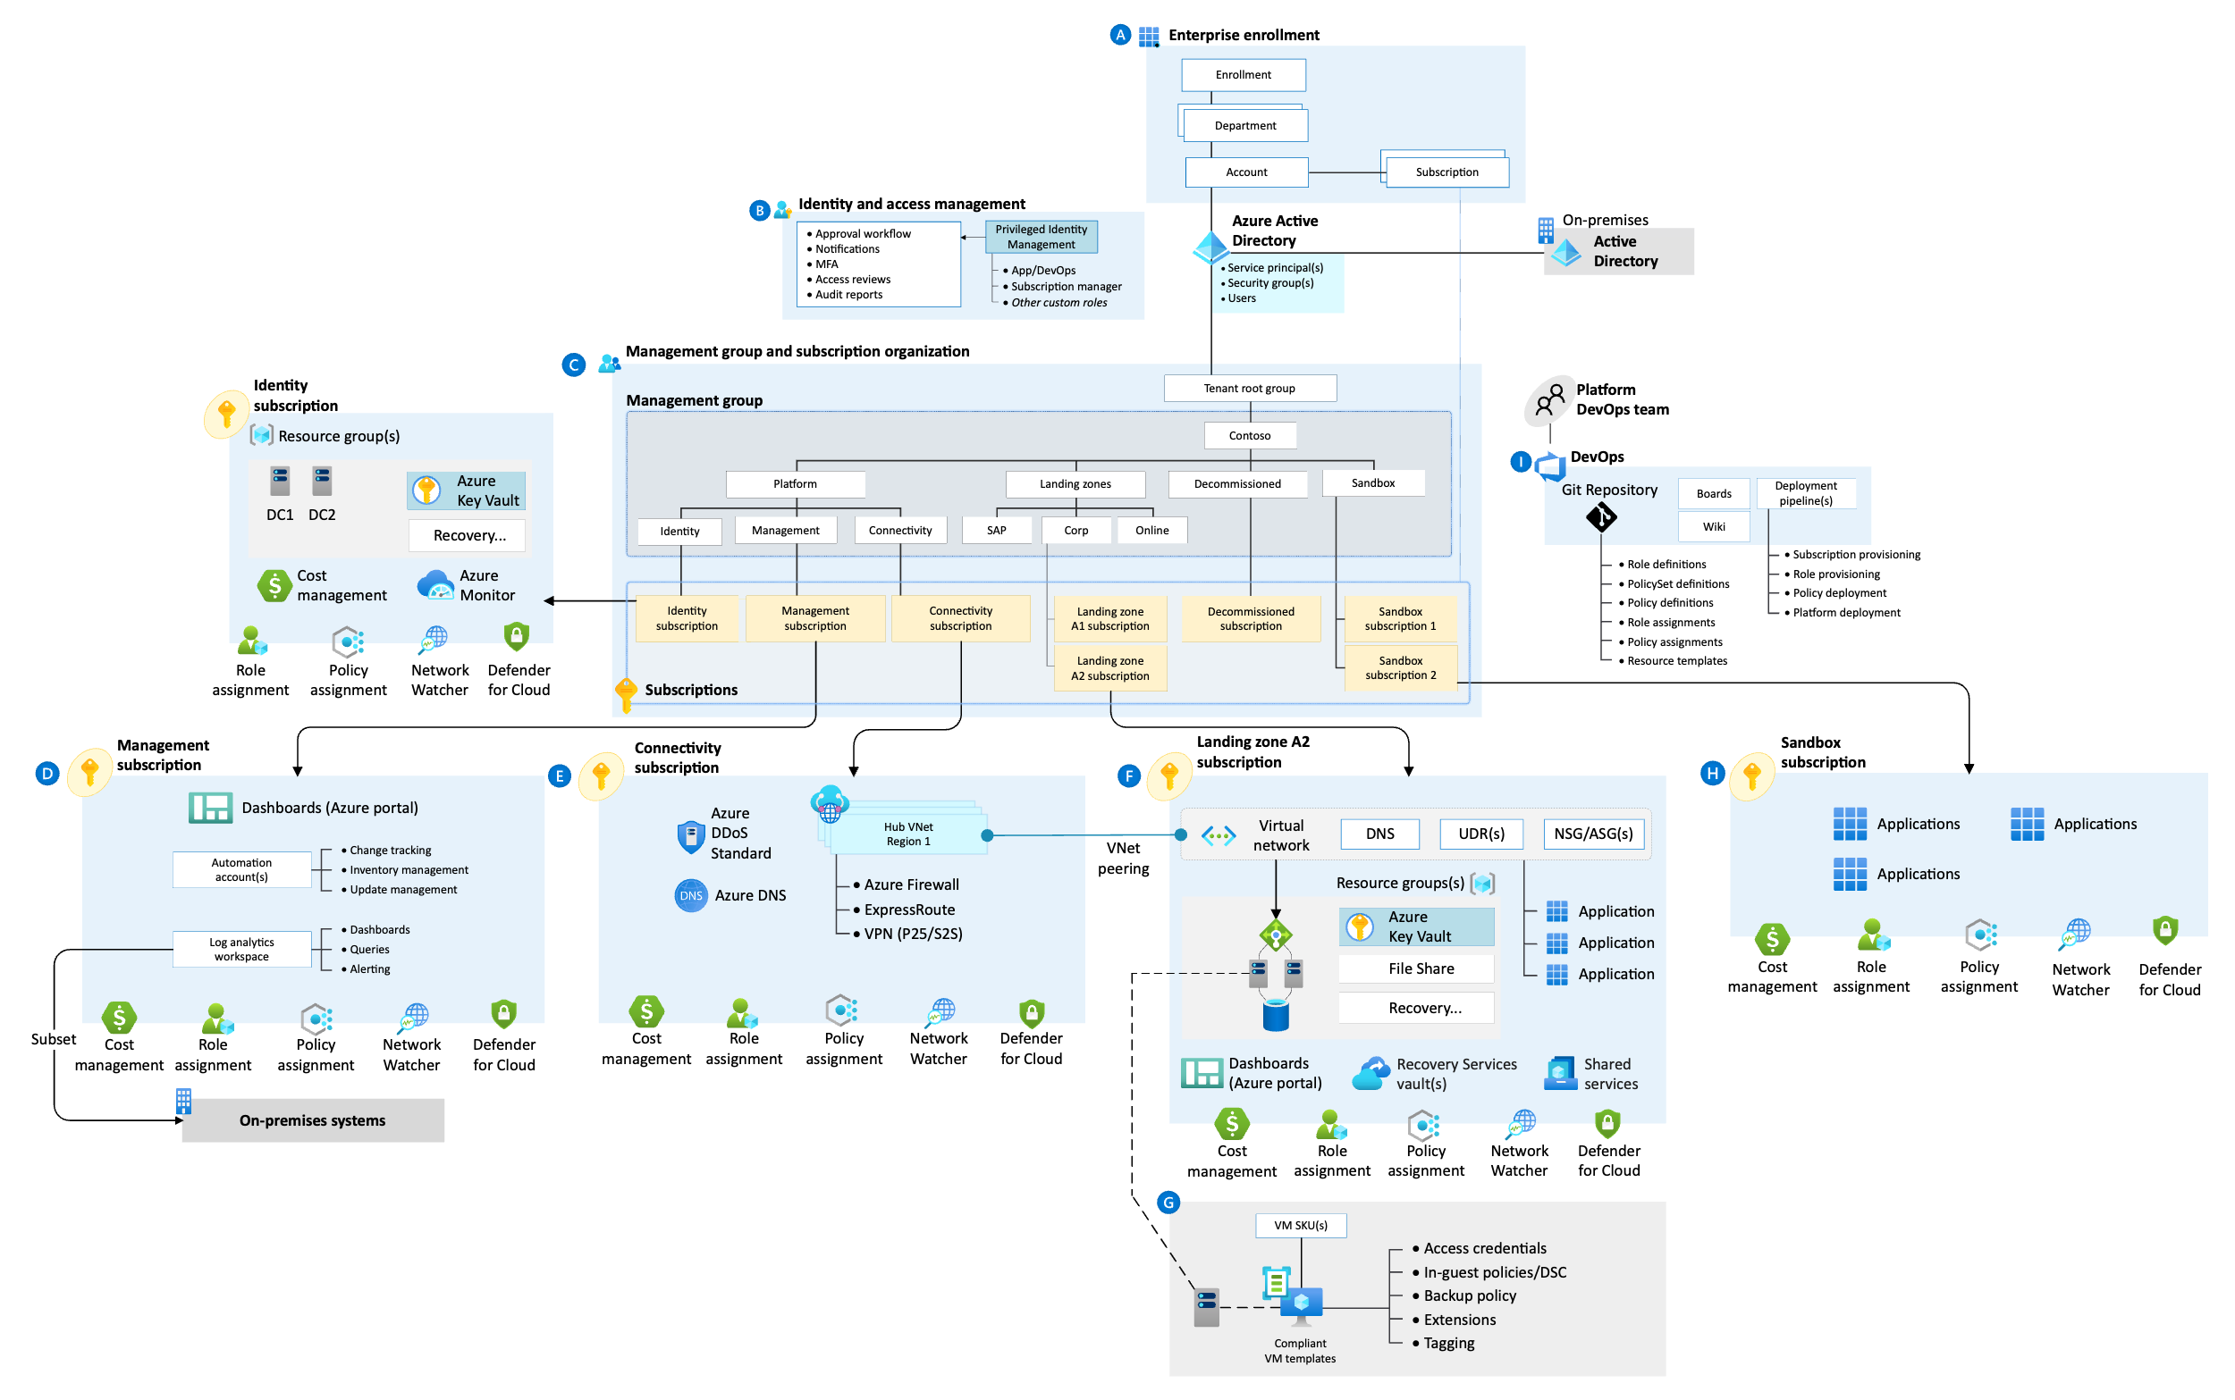
Cloud Landing Zone (Azure)
Build a minimum viable product (MVP) with a future-state in mind :
Naming and tagging
Account structure
Network topology
Identity and access,
Logging
Governance policies
Security controls
…

Slide 51
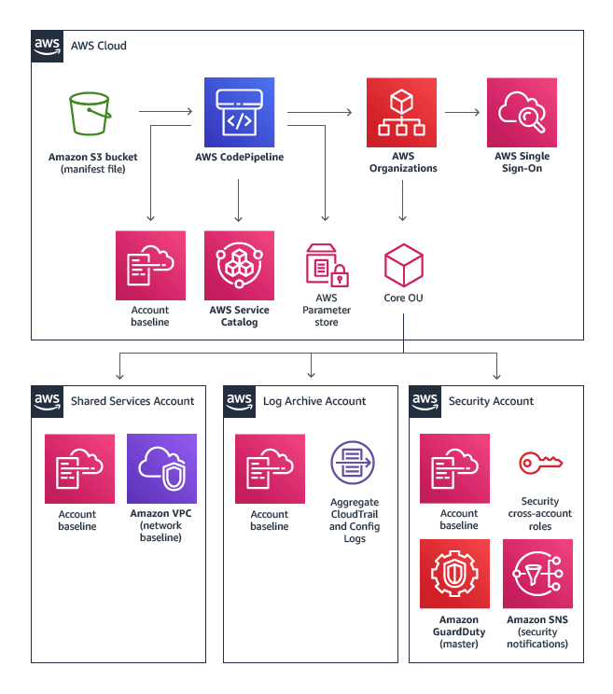
Cloud Landing Zone (AWS)
Build a minimum viable product (MVP) with a future-state in mind :
Naming and tagging
Account structure
Network topology
Identity and access,
Logging
Governance policies
Security controls
…

Slide 52
Organisation Assessment
(Migration Readiness Assessment)

Slide 53
MRA Summary
A Migration Readiness Assessment (MRA) is a process of gaining insights into how far along an organization is in their cloud journey, understanding their current cloud-readiness strengths and weaknesses, and building an action plan to close identified gaps. You can use the Cloud Adoption Framework (CAF) and its six perspectives (business, people, governance, platform, security, and operations) as a framework to help ensure that you have a holistic view of the transformation initiative that is required for an effective move to the cloud.
Three outcomes are expected from a readiness review:
An understanding of where an organization is in its cloud journey
Identified areas of strength and weakness from a cloud-readiness perspective
An action plan to resolve the identified gaps, so the organization can migrate at scale without having to pause to solve foundational issues
In addition, there are often these additional outcomes:
Alignment and consensus building within the team
Identification of best practices within the organization that can be leveraged and scaled
A reduction in roadblocks that can disrupt progress

Slide 54
MRA Readiness Radar Chart
Assess Readiness Perspectives
Pre-Migration Readiness Workstreams
Scores are based on readiness for migration, such as processes tested for cloud and current business understanding or utilisation of cloud offerings.
E.g. using S3 or Blob storage for backups on cloud vs local backups.
Final Scoring for all areas and suggested actions in MRA Folder.
1
2
3
4
5

Slide 55
MRA Workstream Summary – Migration focus areas
Skills & COE
Business Case
Operating Model
Landing Zone
Single Threaded Leader
High Level Business Case
Current Operations Model
Account Design & Configuration
Experience baseline
Key Stakeholder Sign-off
Managed Service Provider Identified
Design or Evolve COE
Migration Funding Commitment
AMI/Patching
Specific Migration Workloads Committed
Cloud Backup
Security & Compliance
Asset Management
Security Strategy
Application Portfolio Discovery & Planning
Config Management & Change Management
Governance, Risk & Compliance
PEOPLE
Application Discovery Data
3rd Party Risk
BCP/DR
Workload Owner Buy-In or Alignment
Service Catalog
Security Reference Architecture
Migration Process & Experience
Cloud Cost Management
Logging & Monitoring
Cloud Migration Experience
Customer Migration Project Plan
Cloud Ready Operational Processes & Run Books
Lifecycle Security Capabilities
Determine Delivery Model & Approach
CI/CD Pipelines
Cloud DevSecOps Principles
Project Management Capability
Incident Response
Security Operations Playbook
Migration Plan
MIGRATION
PORTFOLIO
PLATFORM
Pre-Migration/Areas that need attention early-on

Slide 56

Recommended Actions
Cloud Team (CCoE)
Cloud Strategy
Cloud Governance
Cloud Architecture
Define teams, roles and responsibilities.
Define foundation capabilities and products.
Define performance and measurement mechanisms.
Discover, assess and cleanup the digital estate.
Build a full Business case.
Migration Plan : Define Product and Technology Roadmap.
Define guidelines, policies, procedures, and compliance requirements.
Define a cost allocation and optimization strategy.
Define resource naming and tagging strategy.
Design & Build a well-architected, compliant and secure landing zone.
Define cloud best practices and reference architectures.
Define data/workload classification/exception framework.
Cloud Operations
Cloud Education
Cloud Partnership
Define platform engineering products (IaC).
Define operational runbooks and playbooks.
Define an observability strategy.
Define a self-service training and a role-Based cloud curriculum.
Promote certification and learning with incentives.
Knowledge Sharing and Innovation.
Identify and engage with strategic partners.
Maximize partner resources: funding, knowledge, experience.
Leverage cloud migration programs.

Slide 57
Additional Strategic Insight

Slide 58
Challenges
Skills Gap
Standardised Access
Cloud Skills required
Suggest partner to aid during transition phase
Build fully featured LZ
Assist with migrations
Develop core security practices
Build foundational FinOps concept
Develop DevOps automation processes
Upskill in-house team
Consistent logins required for administrator access
Standardised login methods for Linux/Windows
Standardised accounts across MOL/ANL
Ability to make changes
Some customers prefer to use a tool to manage PAM. (eg: Cyberark)
Vmware Tools
Legacy OS
Where possible having vmware tools enabled gives a better perspective of performance inside the VM
Update where possible
Old unsupported OS types will take longer to move to Cloud
Replatforming is possible but must be factored into timeline.

Slide 59
Challenges
Appliances
Naming Conventions
challenge
response
Risk of duplication or accidentally leaving out of migration
Same hostnames with .int and .hsk
h3
h4
c3
r3
c4
r4

Slide 60
Application Assessment
(Migration Portfolio Assessment)

Slide 61
MPA Deliverables
High level portfolio review
Assessment of as-is application attributes
Outcomes:
Complexity Assessment
Defined Migration Scope
Complexity Classification per Application
Application Profile
Indicative Migration Strategy per Application
High Level Release Plan
Estimated Cost of Migration & Operation
Examine key migration impacting characteristics
Application to server mapping
Application inter-dependencies
Application Profiling
*
Supports future-state operating cost analysis
Environment stats collected including:
Virtual Server information & utilisation (CPU, Memory, Disk Utilisation, NIC)
Infrastructure Discovery
*Completed by Infra Discovery Workstream

Slide 62
Migration Strategy Selection
Containers / VMWare Cloud on Hyper-Scaler Platform
Determine Configuration
Manual
Install
Configure
Deploy
Automate
Relocate
Use Migration tools
We are here
Rehost
Determine
New Platform
Modify underlying
infrastructure
Replatform
Replace
Discovery
Assess & Prioritise
Determine Migration
Strategy
Purchase COTS / SaaS &
Licensing
Manual install
& set up
Validation
Migration
No Migration
Refactor
Retain As-Is
Retire or
Decommission
Redesign application / Infrastructure
App Code
Development
Full ALM / SDLC
Integration
Production

Slide 63
Applications and Services In Scope for Migration
Name | Virtual Servers Count |  | Name | Virtual Servers Count
Achilles.com | 6 |  | My Insight (https://myinsight.achilles.com/Reports/browse) - User Lane reports | 1
Thompson Reuters | 4 |  | Hackolade | 1
MyAchilles | 77 |  | Nagios Monitoring | 1
Central Reporting | 2 |  | Netsuite | 1
Domain Controllers – INTERNAL ACHILLES | 3 |  | Analytics Data Platform (aka SAP-IQ) | 1
Azure DevOps | 2 |  | Qualys appliance | 1
Bomgar Appliance | 1 |  | SCCM | 2
DevOps - Jenkins, FileServer | 6 |  | Service Desk | 4
Domain Controllers - Non Prod | 2 |  | StartBank | 2
Duo Multi–factor App | 1 |  | SMTP Server | 1
Eclipse | 3 |  | Taegis appliance | 1
ELK | 3 |  | Telephone call log | 1
Achilles File Server | 1 |  | Dynatrace | 1
Jenkins DNS & File Servers - Infra & Citrix Netscaller | 2 |  | GoSupply | 26
Load Balancer | 1
Total
29 Apps / Services
158 Virtual Servers Total
*final count of servers will differ in cloud
64 DB Virtual Servers

Slide 64
Workload Summary
MIGRATION
COMPLEXITY
Basic: 13
Standard: 8
Complex: 2
Super Complex: 0
Unclassified: 6
(Shared Services)
Business Applications in scope for Cloud Migration
10
Shared Services & Appliances in scope for Cloud Migration
19
Applications out of scope
for Migration Services
Data Centre Exit Dates
3
DDC – May 2025 LEPC – Oct 2025
MIGRATION STRATEGY
Move
Modernise
Maintain
Mothball
Rehost
Replatform
Refactor
Replace
Retain
Retire
27
1
1*
0
0
3
Rackspace Migration Services
Customer-Led Alternatives
Rackspace Migration Services will assist with moving and modernising customer workloads into the chosen target Cloud.
The ‘Move’ bucket includes all applications that will migrate like-for-like using either a new build or image-based approach.
Applications in the ‘Modernise’ bucket may have varying degrees of transformation associated with the migration. This may impact the overall timeline and will involve coordinating multiple stakeholders
Applications that are not suitable for the cloud as-is will either modernise to embrace a SaaS platform, or an entirely new application may be deployed straight into target. In either scenario the customer is unlikely to benefit from Migration Services.
In some cases the customer may choose to maintain the application in source, at most an understanding of the application affinity will be required to understand the impact of migrating closely-coupled interfaces.
Applications to be mothballed do not require any migration services, however the customer should consider the data retention requirements and how this data will be recovered after the application has been decommissioned.
*If GoSupply Migrates to AWS.
In the case of GoSupply staying in Azure no R–treatment is required.
64

Slide 65
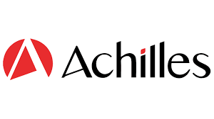
Classification | Scope | Strategy
Complex | In Scope | Rehost
MyAchilles
Knowledge Level
Business Criticality
MyAchilles is a web-based supply chain risk management platform that enables supply chain data collection, analysis, and sharing in a simple and seamless manner. (Crown Jewel Application). Estimated at 500k users.
Application Stats
Description
Dependencies
5 Interfaces
Infrastructure &
Technology
Running on Windows Server 2016 & 2019, Linux RHEL 7.9 & 9 and Linux RedHat Enterprise 7 & 8
Database Engines Include: NEO4J, SQL, MongoDB, Redis, IQ, Elastic Search and FileStorage.
Blue / Green Deployment.
Use of Jenkins, Azure DevOps, CI/CD ad–hoc pipelines and Scheduled Cron Jobs for Automation.
Databases
7 Database Engines
16 TB total size (Prod)
Production and Staging hosted in DDC. Staging, App Support, DEMO, DEV, DEV–DMT and QA hosted in LEPC.
DR running in AWS, not tested fully end to end.
All Env’s running on VMware.
Business Criticality
Environments
Level - High
Migration Considerations
Knowledge Level
Currently have a Blue / Green Deployment, recommendation is to prepare a parallel env in Cloud, and failover to new deployment (a parallel run of the application to minimise downtime)
Interfaces with many other applications receiving and sending large volumes of data.
Accessed directly by users across different regions and time–zones
Includes interfaces with external APIs and 3rd party suppliers
Downtime must be minimal, outages from previous supplier has left Achilles customers frustrated.
Assumption – NEO4J will be upgraded in source before migration.
Level - High
File Data Volume
12TB Data
65

Slide 66
High-Level Release Plan – Azure
WK | 1 | 2 | 3 | 4 | 5 | 6 | 7 | 8 | 9 | 10 | 11 | 12 | 13 | 14 | 15 | 16 | 17 | 18 | 19 | 20 | 21 | 22 | 23 | 24 | 25 | 26 | 27
LZ Design and Build – Wave 0
Core and Wave 1 Shared Services
Wave 1 (MyAchilles Included)
Wave 2
Wave 3 & Wave 3 Shared Services
Wave 4
Wave 5
Wave 6 (GoSupply)
Production & Staging Final Migration Estimate – 12 weeks
Non–Production Final Migration Estimate – 20 weeks
GoSupply Final ‘Migration’ Estimate – 23 Weeks (if Transitioning into New Azure Tenant)
*Detailed High–level Release Plan in Reference Documentation
Release Plan is planned on an estimate of 15–20 hours on avg. weekly for Achilles to engage in workshops and data gathering. (doesn’t include time required for app deployment, testing etc)

Slide 67
High-Level Release Plan – AWS
WK | 1 | 2 | 3 | 4 | 5 | 6 | 7 | 8 | 9 | 10 | 11 | 12 | 13 | 14 | 15 | 16 | 17 | 18 | 19 | 20 | 21 | 22 | 23 | 24 | 25 | 26 | 27
LZ Design and Build – Wave 0
Core and Wave 1 Shared Services
Wave 1 (MyAchilles Included)
Wave 2
Wave 3 & Wave 3 Shared Services
Wave 4
Wave 5
Wave 6 (GoSupply)
Production & Staging Final Migration Estimate – 12 weeks
Non–Production Final Migration Estimate – 20 weeks
GoSupply Final Migration Estimate – 27 Weeks (if Migrating to AWS)
*Detailed High–level Release Plan in Reference Documentation
Release Plan is planned on an estimate of 15–20 hours on avg. weekly for Achilles to engage in workshops and data gathering. (doesn’t include time required for app deployment, testing etc)

Slide 68
Migration Scope and Detailed Waves.
Migration Scope
Wave | Application | Migration Approach | Env's | Classification
0 | LZ Build | n/a | All | n/a
1 | Core Shared Services | Build New | Prod / Dev / Staging | n/a
1 | Shared Services For Wave 1 | Build New | Staging / Prod / Dev | n/a
1 | MyAchilles | Re–Platform Greenfield | Staging / Prod | Complex
1 | Thompson Reuters | Re–Host Greenfield | Staging / Prod | Standard
1 | Achilles.com | Re–Host Greenfield | Staging / Prod | Standard
1 | Central Reporting | Re–Host Greenfield | Staging / Prod | Standard
1 | Nagios Monitoring | Re–Host Greenfield | Prod | Standard
1 | Netsuite | Re–Host Greenfield | Prod | Basic
2 | Eclipse | Re–Host Image | Staging / QA | Standard
3 | Shared Services For Wave 3 | Build New | Prod | n/a
3 | Service Desk | Re–Host Image | Prod & Dev? | Basic
3 | Telephone call log | Re–Host Image | Prod | Basic
4 | My Insight | Re–Host Greenfield | Prod | Basic
4 | Hackolade | Re–Host Image | Dev | Basic
4 | StartBank (Archive)* | Re-Host Image | Prod | Basic
5 | MyAchilles | Re–Host Greenfield | DEV / App Support / Demo / Dev / Dev–DMT / QA | Complex
5 | Central Reporting | Re–Host Greenfield | Dev | Standard
5 | Thompson Reuters | Re–Host Greenfield | Dev | Standard
5 | Achilles.com | Re–Host Greenfield | Dev | Standard
6 | GoSupply Azure to AWS** | Refactor | Prod/UAT | Complex
Shared Service List
Shared Services Scope
Shared Service | Release
Domain Controllers Non Prod | Core Shared Service
Duo Multi–factor App | Core Shared Service
ELK | Core Shared Service
Load Balancer | Core Shared Service
Qualys appliance | Core Shared Service
SMTP Server | Core Shared Service
Taegis appliance | Core Shared Service
Dynatrace | Core Shared Service
Azure DevOps | Wave 1
DevOps / Jenkins File Server | Wave 1
Analytics Data Platform SAP IQ | Wave 1
MyAchilles Domain Controllers | Wave 1
Domain Controllers (Internal Achilles) | Wave 3
Bomgar Appliance | Wave 3
Achilles File Server | Wave 3
Jenkins DNS / FileServers / Citrix Netscaler | Wave 3
SCCM | Wave 3
*Startbank is only being kept for archival purposes, assumption is an image copy would be migrated to cloud.
**Only applicable if Achilles choose to migrate to AWS vs Azure.

Slide 69
Greenfield Migration approach
Image Migration approach
Pro
Con
Pro
Con
‘Application / client first’ approach.
SQL/Database setup & config in Cloud before Cutover.
Safely test in Cloud before Cutover.
Ideal for critical workloads.
Option to Replatform / Re-size.
Setup DR in Cloud before Cutover & DR testing (optional)
Separate Apps that run on the same server.
Parallel run possible.
Reduced Downtime for migration event.
Requirement for a lot of time from Achilles Teams for app deployment, testing etc.
Longer project timelines.
Non-Prod migration events not co–ordinated, unless requested.
Tool-based, ‘infrastructure’ approach.
Ideal for apps that can tolerate move & fix-forward.
Potential shorter project timeline.
Ideal for low criticality / standalone applications.
All Cutover events are RXT coordinated and performed by RXT engineers.
RXT resources for migration prep & execution (not app testing).
No app re-deployment.
Application config & testing in Azure not possible before Cutover events.
Longer migration windows per event (depending on #Virtual Servers).
DR Implementation after Cutover event.
Only applicable for non-clustered services.
Rehost (lift & shift) for app Virtual Servers only.
Parallel run for the same Virtual Servers not possible.
A Hybrid of Both Approaches can be taken for different workloads.

Slide 70
8 Step Pipeline Methodology
TIMELINE
GOVERNANCE
Release
Planning
ENGAGE
ASSESS
DESIGN
PLAN
MIGRATE
HYPER CARE
CLOSE
Complexity Assessment
App
Profiling Workbook
Project Readiness
App
Charter
Business
Service &
Arch. Maps
Assessment
Workbook
Migration Strategy
Migration
Storyboard
Migration Runbook
/Workbook
Migration Event Schedule
Change
Management
Migration Events
Acceptance Testing
Service Health Check
Transition to
Managed Service
Feedback/
Lessons learnt
Project
Review
Initial
Release
Plan
Kick
Off
Application Readiness
Automation
Assessment
Automation
Readiness
BUILD
If in scope
Customer responsibility
SOLUTION ARCHITECTURE
Implementation
Workbook
Operational Runbook
Deliverable dependent on classification
High Level
Design
Est. Cost of
Operation
Reference Architecture
Detailed
Design
Environment Build
Application Install & Test

Slide 71
Reference Documentation
Completed Application Profiling Workbook – Including Analysis
App to Server Mapping
Release Plan

Slide 72
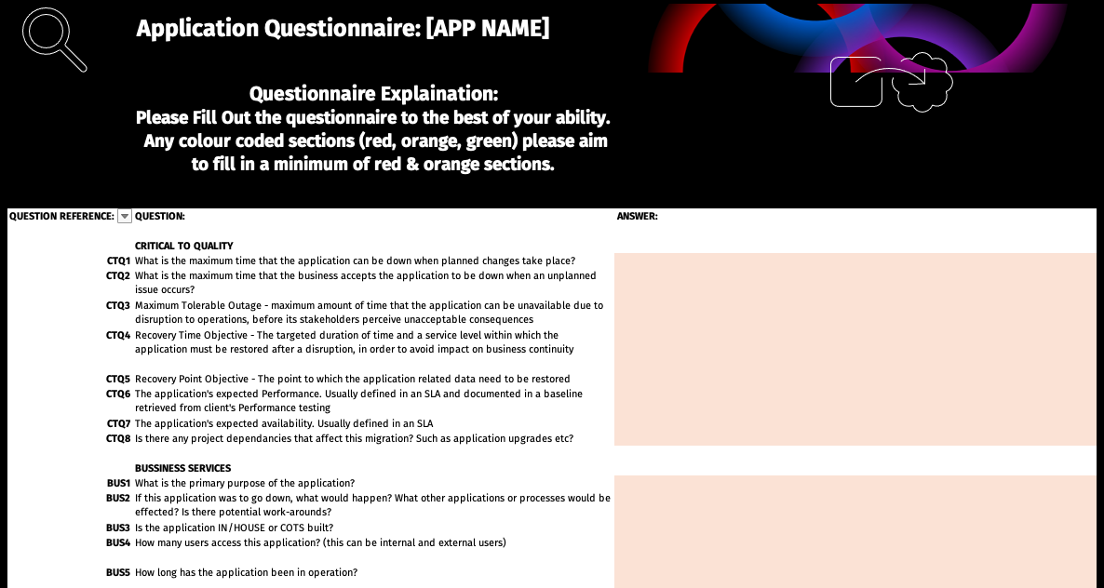
Preparing for the Migration
ASSESS
The app charter is a vital deliverable to understand your applications as thorough as possible prior to migration. We utilise this deliverable to create the future state architecture and refine migration strategies for low-level items such as database, network, server, local data etc.
The questionnaire on the left aids us with getting the initial information to hand before workshops for assessments begin.
Though not a necessary pre–project requirement, it’s recommended to start filling out a questionnaire per application in scope during the transitional phase between projects, so we start with more data early on. Any questions that cannot be answered can be addressed in workshops once the migration project starts.
Without the questionnaires we will rely purely on workshops to gather information which can be more time consuming if data isn’t readily available.
App
Charter
Business
Service &
Arch. Maps
Assessment
Workbook
Automation
Assessment
Automation
Readiness
If in scope
Customer responsibility
Deliverable dependent on classification
Fill out questionnaire per application e.g. 12 apps = 12 questionnaires.
Please find to the right the list of apps to fill out for.
Link to app charter questionnaire found here
MyAchilles
Thompson Reuters
Achilles.com
Central Reporting
Nagios Monitoring
Netsuite
Eclipse
Service Desk
Telephone call log
My Insight
Hackolade
StartBank (Archive)*
Level 1 Information
Level 2 Information
Level 3 Information
Goal is to aim for Level 2 and above for information (colour coding found in questionnaire)
*StartBank is archival data, if functionality of the app isn’t required then no need for questionnaire.

Slide 73
Security Assessment

Slide 74

Discovery Summary
Security Practices
Use on-prem security as foundation for new cloud platform
Focus on continued improvement, evolution and stability building the landing zone using cloud native tooling and features, on the target cloud
74

Slide 75
Goals, Objectives and Findings
Goals & Objectives
Cloud Readiness Assessment.
Assess current security measures and align them with cloud-native solutions for improved protection.
Pick a suitable cloud provider based on selection criteria to support, grow and enhance the security requirements
Findings
The Achilles team understands the criticality for layered security and is forward thinking.
Achilles have implemented various technology solutions and products, for their Corporate Applications, and MyAchilles platform running on Third Party Data Centre environment.
Achilles can use on-prem security as foundation for new cloud platform.
There is an existing small AWS, Azure footprint, secured by current security tooling.
MyAchilles has about 20-30 secrets (credentials, certificates, serial number etc.).
GoSupply uses Azure Key Vault is to Securely store and tightly control access to tokens, passwords, certificates, API keys, and other secrets - but there are open high and medium security recommendations flagged in Azure Advisor which should be addressed.
ISO2701 is followed and PCI/DSS and GDPR compliance adherence is desired in future state cloud provider.
Achilles has ISMS and required enterprise policies.
Current Infrastructure follows “closed build” private data center strategy.
75

Slide 76
Security Tooling - Current
Achilles current security infrastructure is robust, leveraging multiple tools to address key cybersecurity areas such as authentication, endpoint security, vulnerability scanning, and threat detection. As part of the migration, cloud native features of the tools will be used as appropriate, such as threat detection, encryption. Here’s a summary of Achilles key technologies:
Key Tool | Functionality
Duo (MFA) | Multi-factor authentication for users.
Sophos | Antivirus, Laptop encryption management, web filtering, security awareness training and phishing testing.
Mimecast | Attachment scanning, URL scanning, impersonation protection, secure large file sending, and email archiving.
Taegis XDR | Advanced threat detection, server and firewall monitoring.
Qualys | Endpoint, server, and web application vulnerability scanning.
M365 Purview eDiscovery | Electronic information search and subject access requests.
Delinea | Password management and privileged access.
Evalian | Penetration testing.
Virtual DCS | Backup and restore services (SharePoint, Exchange, OneDrive).
Citrix | VPN for Corp End Point connections.
Vinciworks | Online security awareness training.
76

Slide 77
Cloud Native Tooling
Current Tooling | AWS | Azure
Duo (MFA) | IAM Identity Center | Azure AD Multi-Factor Authentication (MFA)
Sophos | Amazon GuardDuty | Microsoft Defender for Endpoint
Mimecast | - | Microsoft Defender for Office 365
Taegis XDR | AWS Security Hub / Amazon GuardDuty | Azure Sentinel / Microsoft Defender
Qualys | Amazon Inspector / AWS Security Hub | Microsoft Defender Vulnerability Management / Microsoft Defender for Cloud
M365 Purview eDiscovery | AWS Macie | Microsoft Purview eDiscovery
Delinea | AWS Secrets Manager / AWS IAM | Azure Key Vault / Azure AD / Just in Time Access
Evalian | Amazon Inspector / AWS Security Hub | Microsoft Defender Vulnerability Management / Microsoft Defender for Cloud
Virtual DCS | AWS Backup | Azure Backup
Citrix | Amazon WorkSpaces | Azure VPN Gateway
Vinciworks | - | -
77

Slide 78
Managed Security
Current Tool | Rackspace Managed Security | Comments
Duo (MFA) | Rackspace Identity Advisory Services | Assessment and recommendation plan for improved identity management & Optimised security and performance utilising best practices.
Sophos | Managed EDR powered by Crowdstrike | Combines cloud-native threat protection and near real-time threat intelligence with AI-assisted Rackspace security experts to detect and respond to vulnerabilities that expose your business to risk.
Mimecast | TBD: To either continue with this tool or use cloud native tooling as suggested in Slide 65
Taegis XDR | Managed XDR powered by Microsoft Sentinel | A cloud-native managed security service that combines cloud-native SIEM technology, AI/ML and Rackspace Security Experts to deliver proactive detection and response capabilities - 24x7x365. Backed by a SOC.​
Qualys | Managed VMDR powered by Qualys | Combines cloud-native vulnerability management technology with Rackspace Security Experts to deliver a risk-based, integrated, vulnerability detection and response capability across your multi-cloud environment 24x7x65.
M365 Purview eDiscovery | TBD: To either continue with this tool or use cloud native tooling as suggested in Slide 65
Delinea | Rackspace Identity Advisory Services | Assessment and recommendation plan for improved identity management & Optimised security and performance utilising best practices.
Evalian | TBD: To either continue with this tool or use cloud native tooling as suggested in Slide 65
Virtual DCS | TBD: To either continue with this tool or use cloud native tooling as suggested in Slide 65
Citrix | TBD: To either continue with this tool or use cloud native tooling as suggested in Slide 65
Vinciworks | TBD: To either continue with this tool or use cloud native tooling as suggested in Slide 65
78

Slide 79
AWS vs Azure comparative assessment
Security and Compliance
Certification & Standards
Data Privacy (Sovereignty)
Platform Capability
Platform Maturity
Both AWS and Microsoft Azure meet the critical requirements for security and compliance, making them reliable choices for cloud services. They provide robust certifications and standards, ensuring adherence to global regulatory frameworks. Both platforms are equipped to handle data privacy and sovereignty needs, supporting Organisations with jurisdiction-specific requirements. AWS excels in global infrastructure, encryption, and compliance support, while Azure shines with integrated governance tools, hybrid sovereignty capabilities, and specialized sovereign clouds, which makes data flow monitoring and auditing easier.
Achilles regulatory compliance requirements can be met by both providers for:
PCI – DSS : Both AWS and Azure are PCI-DSS level 1 certified and has a list of preapproved services that customer can use
ISO2701 : ISO2701 Certified and has way to implement controls to support in cloud environment
GDPR : Both cloud providers have a mechanism in place to support data sovereignty requirements.
Additionally, their advanced platform capabilities and maturity reflect their long-standing expertise and scalability, ensuring support for diverse workloads and enterprise needs.
79

Slide 80
GoSupply – Azure Advisor Review
​
Findings
Azure Advisor reports Several open security recommendations flagged which should be addressed. ​
There are total 59 findings across High, Medium and Low priority, reported across 642 resources. ​
There are 19 High Priority and 27 Medium priority findings. ​
The detailed file with all findings can be found here - GoSupply Azure Security Extract - 18 Dec 2024.xlsx​
Recommendations
We recommend that these findings should be looked at and analysed for a potential business impact.
The team should remediate starting with high priority and working down.
Create a Risk Register and assign the findings to respective (platform/storage/webapp) owner and track the fix or remediations to completion. ​
Key issues in the high findings relate to webapp communication which is critical for secure communication and information transfer.
80

Slide 81
GoSupply – Azure Advisor Review – High Severity Issues
Issue | Affected Resources
FTPS should be required in web apps | 59
Windows virtual machines should enable Azure Disk Encryption or EncryptionAtHost. | 6
Machines should be configured to periodically check for missing system updates | 6
All network ports should be restricted on network security groups associated to your virtual machine | 3
SQL databases should have vulnerability findings resolved | 2
TLS should be updated to the latest version for function apps | 2
Microsoft Defender for APIs should be enabled | 1
Microsoft Defender for Resource Manager should be enabled | 1
Microsoft Defender for Storage plan should be enabled with Malware Scanning and Sensitive Data Threat Detection | 1
Issue | Affected Resources
There should be more than one owner assigned to subscriptions | 1
FTPS should be required in function apps | 1
Secure transfer to storage accounts should be enabled | 1
Disabled accounts with read and write permissions on Azure resources should be removed | 1
Linux virtual machines should enable Azure Disk Encryption or EncryptionAtHost. | 1
Guest accounts with write permissions on Azure resources should be removed | 1
SQL servers should have an Azure Active Directory administrator provisioned | 1
Microsoft Defender CSPM should be enabled | 1
Microsoft Defender for App Service should be enabled | 1
81

Slide 82
GoSupply – Azure Advisor Review – Medium Severity Issues
Issue | Affected Resources
Diagnostic logs in App Service should be enabled | 109
Managed identity should be used in web apps | 103
Web Application should only be accessible over HTTPS | 94
Storage accounts should restrict network access using virtual network rules | 16
Storage accounts should prevent shared key access | 16
Storage account should use a private link connection | 16
Storage account public access should be disallowed | 14
Virtual machines and virtual machine scale sets should have encryption at host enabled | 7
Guest Configuration extension should be installed on machines | 7
Public network access on Azure SQL Database should be disabled | 2
Function apps should have Client Certificates (Incoming client certificates) enabled | 2
Azure DDoS Protection Standard should be enabled | 2
Key vaults should have purge protection enabled | 2
Firewall should be enabled on Key Vault | 2
Azure SQL Database should have Azure Active Directory Only Authentication enabled | 2
Azure Key Vaults should use private link | 2
Issue | Affected Resources
Managed identity should be used in function apps | 2
Azure Cosmos DB accounts should have firewall rules | 1
CosmosDB accounts should use private link | 1
Azure AI Services resources should have key access disabled (disable local authentication) | 1
Machines should have a vulnerability assessment solution | 1
VPN gateways should use only Azure Active Directory (Azure AD) authentication for point-to-site users | 1
Azure AI Services resources should use Azure Private Link | 1
Azure AI Services resources should restrict network access | 1
Function App should only be accessible over HTTPS | 1
Private endpoint connections on Azure SQL Database should be enabled | 1
Azure Cosmos DB should disable public network access | 1
82

Slide 83
Security assessment recommendations
Both AWS and Azure have the security native features and tooling to satisfy Achilles security needs. Cloud security baseline implementation should enable native tooling for infrastructure & network protection, Data protection/encryption, credential and secret management, Threat detection and response, Logging and monitoring.
Adopt cloud-first approach in security framework, regulation, compliance and governance enforcement. Use current policies to built and implement the cloud controls to satisfy compliance requirements.
Focus on continued improvement and evolution with same or similar security with cloud native tooling functionality. Use cloud provider features where possible such as encryption, secret management, network segmenting, backup/DR and extend rest of security capabilities via current tooling.
Design environments around the idea of "Blast radius". The blast radius concept involves designing your cloud security model in such a way that it limits the damage any one issue could cause. This is mainly achieved by isolating workloads in subscriptions/accounts so that the variety of workloads. allowed
Adopt a policy as code approach that includes for each policy or approved use case. This code-based approach can simplify audit and provide a set of comprehensive guardrails that can in most cases stop an issue before it is deployed.
Utilize required cloud foundational security services to protect infrastructure and platform layers and implement critical boundary defense cloud services (DDOS Protection, Firewall, IPS & WAF).
Implement a full Data Protection and data lifecycle management in the cloud.
Review the current Policies & Procedure and align them to the cloud environment. Create Cloud specific policies and implement the controls out of the policies. For example, Create the Data Protection cloud specific policy that covers, encryptions management, Key management, Data archival requirements. Implement specific controls/features in the cloud to help enforce it.
83

Slide 84
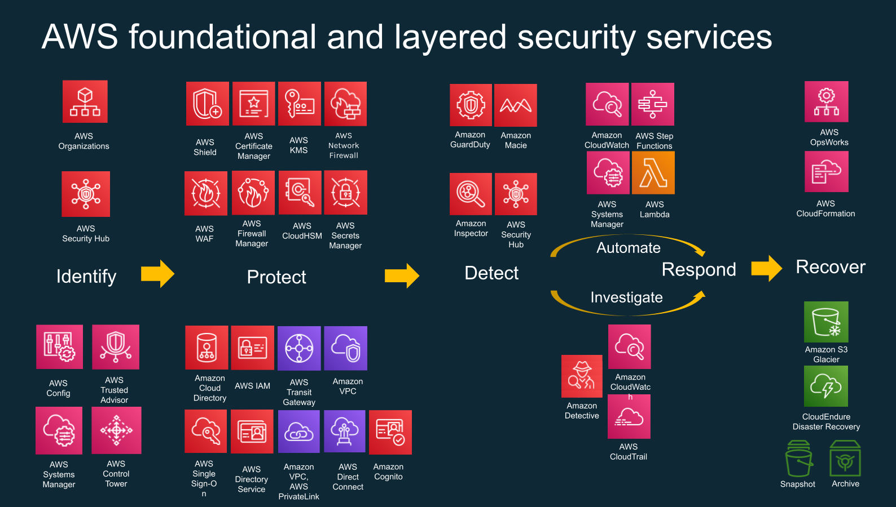
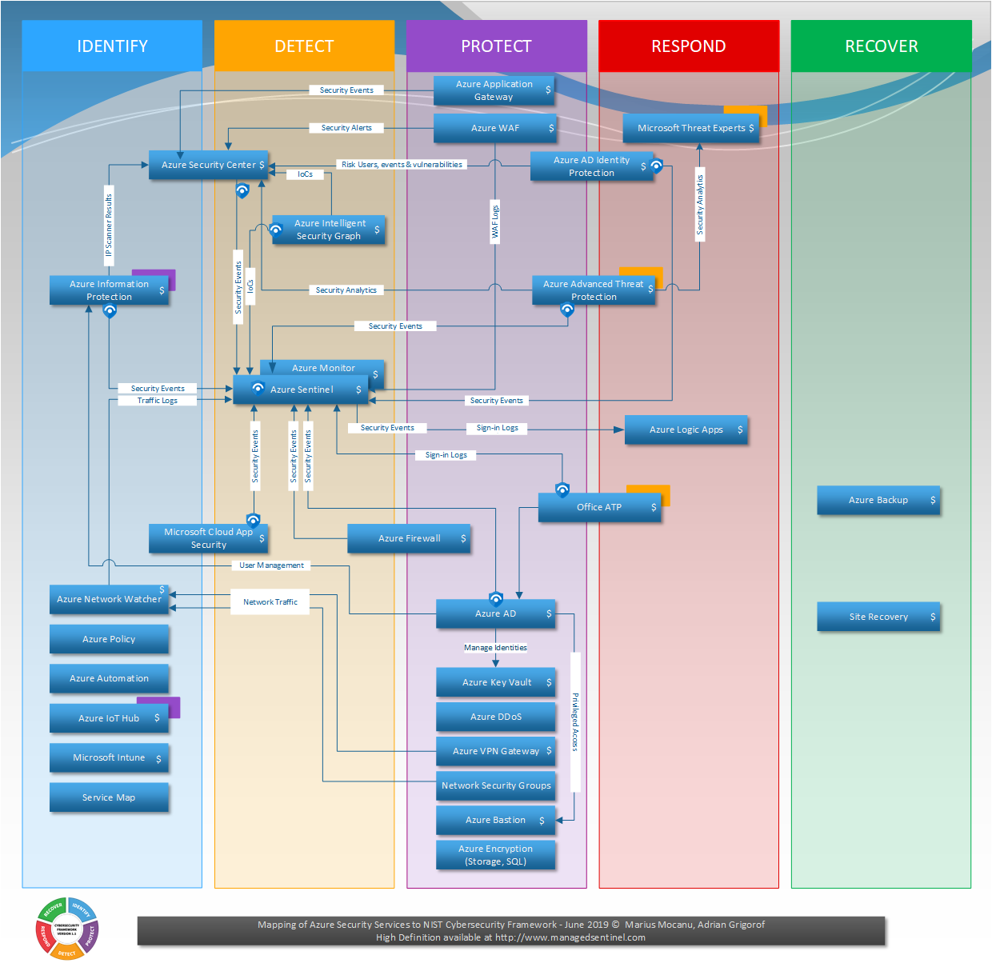
Cloud-native services available for Future State
Here is the list of end-to-end security services and tooling available for AWS and Azure. These services will be utilized, as applicable and per use cases, as part of the landing zone implementation. Such as AWS GuardDuty, Shield, Security Hub, Inspector, Macie and Microsoft Defender products, Microsoft Sentinel, Purview, encryption. requirements. Implement specific controls/features in the cloud to help enforce it.
Additionally, compliance stack for ISO, PCI and the Cloud provider best practices can be enabled.
84

Slide 85
Cloud Economics

Slide 86
Cloud Economics - Methodology
Objectives
TCO Report comparing AWS and Azure costs from Compute, License, Storage, Backup, Network & Cloud Support over 3-year timeline.
Methodology
AWS MPA and Azure TCO Calculator was used to calculate Compute, License, Storage and Cloud Support.
AWS Cost Calculator and Azure Cost Calculator was used for calculating Backup costs to have a common method of calculating backup costs as TCO engine on both AWS and Azure side calculated Backup costs differently.
TCO for both Azure and AWS will be on listed pricing with Hyperscaler funding credits applied – these credits are subject to final approvals.
Assumptions
AWS & Azure Network cost is 5% of the Compute, License and Storage costs calculated by AWS MPA and Azure Migrate respectively.
Backup.
10% yearly data growth with daily 0.5% data change rate.
Backup retention 7 days for Daily, 4 weeks for Weekly, & 12 Months for Monthly.
OS and SQL License costs are included in the Compute costs.
Enterprise Support plan was assumed for Azure, while AWS MPA recommended Business Support Plan.
All the cost is based on IaaS approach.
Decisions
Achilles requested Rackspace to price 7 regions for both Hyperscalers – Ireland, Germany, Spain, France, US – East, US – West and UAE.
86

Slide 87
Infrastructure Consumption - Economics Summary (USD)
Region | AWS | Azure | GCP
London | $ 2,110,833.69 | $ 1,739,190.12 | $ 2,163,620.69
 | eu-west-2 | uk-south | europe-west2
Germany | $ 1,995,324.63 | $ 2,163,620.69 | $ 2,163,620.69
 | eu-central-1 | germany-west-central | europe-west3
Ireland | $ 1,897,527.74 | $ 1,609,610.72 | N/A
 | eu-west-1 | north-europe | -
Netherlands | N/A | N/A | $ 2,163,620.69
 | - | - | europe-west4
Costing includes the following cloud service:
Compute/Licensing
Storage
Network
Backup
Support and Credits
87

Slide 88
Infrastructure Consumption - Economics Summary (GBP)
Region | AWS | Azure | GCP
London | £1,667,431.97 | £1,373,855.85 | £1,709,130.53
 | eu-west-2 | uk-south | europe-west
Germany | £1,576,186.74 | £1,709,130.53 | £1,709,130.53
 | eu-central-1 | germany-west-central | europe-west3
Ireland | £1,498,933.06 | £1,271,495.89 | N/A
 | eu-west-1 | north-europe | -
Netherlands | N/A | N/A | £1,709,130.53
 | - | - | europe-west4
* Costing includes the following cloud service: Compute/Licensing, Storage, Network, Backup, Support and Credits
** USD to GBP exchange rate used ($1 = £0.78994)
88

Slide 89
Cloud Economics - Conclusion
Notes
United States – West is overall the most cost-effective region, followed closely by United Sates - East.
Ireland stands out as the most cost-effective and mature region for both AWS and Azure in Europe.
UAE is the least cost-effective region in AWS and second last region in front of Germany in Azure.
In Germany, AWS offers lower pricing compared to Azure.
In Ireland, France, and Spain Azure provides more competitive pricing than AWS.
AWS is notably more generous with its credits than Azure.
Currently, Azure operates in 26 countries with 56 regions, while AWS spans 27 countries with 35 regions.
89

Slide 90
Appendix 2 – Cloud Economics – Detailed Analysis - USD

Slide 91
Infrastructure Consumption - London
 | AWS | Azure | GCP
Compute + Licensing | $ 1,184,734.92 | $ 943,380.00 | $ (241,354.92)
Storage | $ 581,269.83 | $ 361,981.58 | $ (219,288.25)
Network | $ 88,300.24 | $ 65,268.08 | $ (23,032.16)
Backup | $ 400,530.96 | $ 247,725.00 | $ (152,805.96)
Support | $ 119,061.94 | $ 161,835.47 | $ (42,773.53)
Credits | $ (263,064.19) | $ (41,000.00) | $ (222,064.19)
Total (3 Years) | $ 2,110,833.69 | $ 1,739,190.12 | $ (371,643.57)
Total (Yearly) | $ 703,611.23 | $ 579,730.04 | $ (123,881.19)
Total (Monthly) | $ 58,634.27 | $ 48,310.84 | $ (10,323.43)
Operations Costs?
Migration Costs?
91

Slide 92
Infrastructure Consumption - Europe (Germany)
 | AWS | Azure | GCP
Compute/Licensing | $ 1,044,418.84 | $ 1,124,561.16 | $ (80,142.32)
Storage | $ 596,392.28 | $ 463,549.57 | $ (132,842.71)
Network | $ 82,040.56 | $ 79,405.54 | $ (2,635.02)
Backup | $ 408,088.08 | $ 345,048.00 | $ (63,040.08)
Support | $ 112,994.51 | $ 201,256.43 | $ (88,261.92)
Credits | $ (248,609.64) | $ (50,200.00) | $ (198,409.64)
Total (3 Years) | $ 1,995,324.63 | $ 2,163,620.69 | $ (168,296.07)
Total (Yearly) | $ 665,108.21 | $ 721,206.90 | $ (56,098.69)
Total (Monthly) | $ 55,425.68 | $ 60,100.57 | $ (4,674.89)
92

Slide 93
Infrastructure Consumption - Europe (Ireland + Netherlands)
 | AWS | Azure | GCP
 | Ireland | Ireland | Netherlands
Compute/Licensing | $ 1,018,259.06 | $ 891,925.56 | $ (126,333.50)
Storage | $ 550,488.48 | $ 347,133.07 | $ (203,355.41)
Network | $ 78,437.38 | $ 61,952.93 | $ (16,484.45)
Backup | $ 377,858.88 | $ 198,180.00 | $ (179,678.88)
Support | $ 108,739.05 | $ 149,919.16 | $ (41,180.11)
Credits | $ (236,255.11) | $ (39,500.00) | $ (196,755.11)
Total (3 Years) | $ 1,897,527.74 | $ 1,609,610.72 | $ (287,917.02)
Total (Yearly) | $ 632,509.25 | $ 536,536.91 | $ (95,972.34)
Total (Monthly) | $ 52,709.10 | $ 44,711.41 | $ (7,997.69)
93

Slide 94
Hyperscaler Selection Analysis & Scoring

Slide 95
Cloud Selection Criteria
Rackspace recommends focusing on the following criteria, prioritized based on insights and discussions from the previous workshop(s).
Economics Achieve cost optimization across the entire technology ecosystem by reducing both capital and operational expenses.
Reliability Minimize unplanned infrastructure outages and ensure the continuous availability of services for users.
1
4
Security & Compliance Strengthen the security posture, leverage economies of scale, and enhance control over infrastructure and data sprawl.
Business Agility Achieve operational efficiency by delivering projects faster while leveraging current assets, internal tools, and in-house knowledge.
2
5
Scalability Enhance the performance and scalability of applications to provide an Optimised user experience.
3
95

Slide 96
Summary
Cloud Selection Criteria – Value Dials
Economics
Security / Compliance
Scalability
Reliability
Business Agility
Total Cost of Ownership (TCO)
Infrastructure Costs
Migration Costs
Software Licensing
Credits/Discounts
Certifications & Standards
Data Privacy (Sovereignty)
Platform Capability
Platform Maturity
Global Reach
Elasticity and Autoscaling
Control and Manageability
Service Level Agreements (SLA)
Data Durability
Backup and Recovery
Disaster Recovery
Track Record
Control and Manageability
Business Fit and Alignment
Effort to Achieve Readiness
Time To Migrate (TTM)
Training and Certification
20.00 %
20.00 %
20.00 %
20.00 %
20.00 %
96

Slide 97
Scoring
Objectives
Score each Hyperscaler against the criteria objectively.
Methodology
Each of the five criteria contains specific “value dials” which have been scored between 1 and 5 depending on the evidence assessed – scoring values explained in the table below.
Scoring allows for each criteria and individual value dial to be weighted however Achilles’ decision was to treat each criteria equally.
Because each criteria has a differing number of value dials, the average of the value dial scores is taken so that each criteria returns a single score between 0 and 5 – this means the maximum score is 25.
Detailed analysis around scoring can be found in Appendix 1 – Hyperscaler Selection – Detailed Scoring.
Score | Coverage | Explanation
1 | None | Feature not present or does not meet the requirement.
2 | Low | Minimal achievement or partial compliance.
3 | Moderate | Somewhat achieved; acceptable but not optimal.
4 | High | Mostly achieved; meets most of the expectations.
5 | Full | Fully achieved or exceeds expectations.
97

Slide 98
Cloud Decision Matrix: Economics
Strategic Goals | Value Dials | AWS Score | Azure Score
Attractive Economics How can we save costs in our technology ecosystem as a whole and reduce both capital and operational expenses? | Infrastructure Costs | 4 | 5
 | Migration Costs | 4 | 5
 | Software Licensing | 3 | 5
 | Pricing Flexibility (Savings/Discounts) | 5 | 5
 | Weighted Average | 4.00 | 5.00

Slide 99
Cloud Decision Matrix: Security/Compliance
Strategic Goals | Value Dials | AWS Score | Azure Score
Security, Risk and Compliance How can we increase our security posture, leverage economies of scale, and enhance our ability to standardize and control infrastructure sprawl? | Certifications & Standards | 5 | 5
 | Data Privacy (Residency & Sovereignty) | 4 | 5
 | Platform Capability | 4 | 5
 | Platform Maturity | 5 | 4
 | Weighted Average | 4.50 | 4.75

Slide 100
Cloud Decision Matrix: Scalability
Strategic Goals | Value Dials | AWS Score | Azure Score
Scalability How can we increase the performance of our applications and provide a better user experience? | Global Reach | 5 | 4
 | Elasticity and Autoscaling | 5 | 4
 | Control and Manageability | 5 | 5
 | Weighted Average | 5.00 | 4.33

Slide 101
Cloud Decision Matrix: Reliability
Strategic Goals | Value Dials | AWS Score | Azure Score
Attractive Economics How can we save costs in our technology ecosystem as a whole and reduce both capital and operational expenses? | Service Level Agreements (SLA) | 5 | 4
 | Data Durability | 5 | 4
 | Backup and Recovery | 5 | 5
 | Disaster Recovery | 5 | 5
 | Track Record | 5 | 4
 | Control and Manageability | 5 | 5
 | Weighted Average | 5.00 | 4.50

Slide 102
Cloud Decision Matrix: Business Agility
Strategic Goals | Value Dials | AWS Score | Azure Score
Business Agility How can we become operationally efficient in delivering projects in a shorter period of time? How can I leverage my current assets and internal assets, tools, in-house knowledge, familiarity? | Business Fit and Alignment | 5 | 5
 | Effort to Achieve Readiness | 4 | 5
 | Time To Migrate (TTM) | 4 | 5
 | Training and Certification | 5 | 5
 | Weighted average | 4.5 | 5

Slide 103
Cloud Decision Matrix: Summary
Criteria | Value Dials | AWS |  | Azure
 |  | Score | Average | Score | Average
Attractive Economics | Total Cost of Ownership (TCO) Infrastructure Costs | 4 | 4.00 | 5 | 5.00
 | Migration Costs | 4 |  | 5
 | Software Licensing | 3 |  | 5
 | Pricing Flexibility (Credits/Discounts) | 5 |  | 5
Security, Risk and Compliance | Certifications & Standards | 5 | 4.50 | 5 | 4.75
 | Data Privacy (Residency & Sovereignty) | 4 |  | 5
 | Platform Capability | 4 |  | 5
 | Platform Maturity | 5 |  | 4
Scalability | Global Reach | 5 | 5.00 | 4 | 4.33
 | Elasticity and Autoscaling | 5 |  | 4
 | Control and Manageability | 5 |  | 5
Reliability | Service Level Agreements (SLA) | 5 | 5.00 | 4 | 4.50
 | Data Durability | 5 |  | 4
 | Backup and Recovery | 5 |  | 5
 | Disaster Recovery | 5 |  | 5
 | Track Record | 5 |  | 4
 | Control and Manageability | 5 |  | 5
Business Agility | Business Fit and Alignment | 5 | 4.50 | 5 | 5.00
 | Effort to Achieve Readiness | 4 |  | 5
 | Time To Migrate (TTM) | 4 |  | 5
 | Training and Certification | 5 |  | 5
 | Total Weighted Averages: |  | 23.00 |  | 23.58
 | Coverage Score: |  | 92.00% |  | 94.33%
The weighted scoring shows that both AWS and Azure score highly, with only a negligible margin separating them. This outcome confirms that either provider can ably support your infrastructure, application, security, and business needs.
Given how closely both platforms scored, we recommend refining the decision by reviewing additional strategic priorities - such as product roadmaps (e.g., AI, Marketplace offerings) - and adjusting the criteria weighting to emphasise your key requirements. This will help finalise the best fit for your organisation.

Slide 104
Cloud Marketplace Capabilities
Marketplace | Key Similarities
Maturity & Availability: Global presence with support for multiple regions, countries, and local currencies, backed by a large ecosystem of partners, products, and subscriptions. Product Offering: Public (Self-Service) and private marketplaces, freemium models, free trials, and private offerings with customizable standard or custom agreement terms. Product Category: Granular classification with multiple categories and subcategories for easy search and visibility, plus bundling into solution packages. Product Delivery Models: Offers IaaS (VM/AMI), SaaS, CaaS (Container), DaaS, managed services, professional services, and training & support w/ BYOL. Pricing Models: Flexible subscription, metered, and usage-based pricing to accommodate various customer needs. Partnership: Strong partner ecosystems, co-selling opportunities, marketing support/guidance, incentives/programs.
Marketplace | Key Differences
Maturity & Market Position: AWS marketplace has a larger market share with more transparent data and has been operating since 2012 (13 years). Azure Marketplace, launched in 2014 (11 years), is rapidly growing. Seller Transaction Fees: Both AWS and Azure charge percentage-based transaction fees. AWS ranges between 1.5% and 3%, while Microsoft recently simplified to a flat 3% fee. Purchasing Commitment: Microsoft Commercial Marketplace allows 100% of eligible purchases to count toward MACC commitments, while AWS Marketplace typically credits up to 25% of eligible purchases toward EDP commitments, providing greater flexibility and value alignment for Azure customers.

Slide 105
AI Capabilities – AWS and Azure
Aspect | Explanation | AWS | Azure
Breadth of Services | The variety and scope of AI/ML services offered by the platform. | Amazon SageMaker, Amazon Comprehend, Amazon Rekognition, Amazon Lex, Amazon Forecast | Azure Machine Learning, Azure AI Services-(Speech,Vision,Search,Document Intelligence), Azure Bot Service, Azure Open AI
Flexibility and Customization | The degree of control users have over model building, training, and deployment. | Fine-grained control over infrastructure and algorithms; support for various ML frameworks; ability to build custom models and workflows. | Focus on ease of use and quick deployment; pre-built models and APIs for common tasks; options for customization through AutoML and custom training.
Machine Learning Infrastructure | The underlying computing resources and storage used for ML workloads. | Amazon EC2, Amazon S3, Amazon EMR | Azure Virtual Machines, Azure Blob Storage, Azure Databricks
Open-Source Integration | The platform's compatibility and support for open-source tools and frameworks. | Strong support for open-source frameworks (TensorFlow, PyTorch, scikit-learn); integration with popular tools like Jupyter Notebooks and Git. | Support for open-source technologies like ONNX and Kubernetes; integration with popular IDEs like Visual Studio Code.
Enterprise-Grade AI Solutions | Features and capabilities that meet the needs of large organizations, such as security, compliance, and scalability. | Security features like encryption and access control; compliance certifications (e.g., HIPAA, GDPR); scalability and reliability for production workloads. | Enterprise-grade security and compliance; integration with Azure Active Directory for identity management; solutions for specific industries like healthcare and finance.
Hybrid Cloud Capabilities | The ability to integrate cloud services with on-premises infrastructure. | AWS Outposts, AWS Snow Family | Azure Arc, Azure Stack
Focus/Emphasis | The platform's core strengths and target use cases. | Broad set of tools and services for diverse AI/ML use cases, with a strong emphasis on flexibility and customization. | Strong emphasis on pre-built models, ease of use, and integration with the Microsoft ecosystem, with a focus on enterprise-grade solutions.

Slide 106
Next Steps

Slide 107
Next Steps
Actions
Achilles’ confirm final Hyperscaler decision – adding additional selection criteria or re-allocating weighting to existing criteria.
Rackspace to present migration effort estimates and commercials.
Rackspace to present managed services offerings and commercials.
Achilles’ Review Migration Readiness Assessment recommendations and consider cloud maturity action plan.
Move forward with Achilles’ migration to chosen Hyperscaler.
Achilles to fill in the Application Charter Questionnaire for applications listed ‘Preparing for Migration’ slide – optional.
107

Slide 109
Appendices
Cloud Business Case

Slide 110
Appendix 1 – Hyperscaler Selection – Detailed Scoring

Slide 111
Cloud Decision Matrix: Economics
Criteria | Measurement | AWS Score | Azure Score | Assessment | Conclusions
Total Cost of Ownership (TCO) Infrastructure Costs | Evaluate overall expenses, including migration, licensing, networking, operational, and scaling costs, over a 3–5-year period. | 4 | 5 | Over a 3–5-year period, Azure demonstrates a lower Total Cost of Ownership (TCO) compared to AWS, particularly due to cost-effective options for licensing (via Azure Hybrid Benefit), egress networking costs, and competitive operational costs. While AWS provides robust scaling capabilities, the associated expenses often result in a higher TCO in long-term comparisons. | By choosing Microsoft Azure, Achilles can achieve significant long-term cost savings. While AWS offers cheaper options for certain compute instances, it falls short in key areas such as storage costs, Microsoft licensing benefits, and networking expenses, which could increase costs if Achilles requires additional resources.
Migration Costs | Assess one-time costs for migration, including tools, labor, re-architecting, and incentives offered by providers. Programs fundings, Data Center Exit incentives, funding programs. | 4 | 5 | Both AWS and Azure offer strong migration programs that help reduce costs. They provide funding, tools, and support to make the migration process easier. For example, Azure offers the Azure Migration and Modernization Program (AMMP), which provides credits and resources for moving workloads to the cloud. AWS has a similar program called the AWS Migration Acceleration Program (MAP), which offers funding, technical support, and best practices to speed up migrations. While both programs help minimize upfront costs and ensure a smoother transition, AWS's funding options, particularly in terms of credits, provide a more robust financial incentive compared to Azure. | Achilles can decide to engage with a Cloud Partner such as Rackspace to take full advantage of available migration funding programs and other benefits. This approach will reduce both Total Cost of Ownership (TCO), migration costs, and credits, making the transition more cost-effective. Note due to GoSupply already in Azure, a migration will be simpler and therefore cheaper to Azure than AWS, simply because movement to AWS involves re-platforming. Important: This criterion requires careful consideration, as it may indicate that the hyperscaler offers larger discounts, customized deals, leading to more favourable incentives.
Software Licensing | Measure the ability to reuse or optimize existing software licenses, minimizing additional licensing costs. Optimization, BYOL flexibility, portability. | 3 | 5 | AWS supports a variety of licenses but often requires separate purchase or customization, to comply with licensing agreements (e.g. Oracle, Microsoft licenses). For instance, hosting SQL Server workloads on AWS may involve higher costs compared to Azure. Many enterprises prefer Azure for Microsoft products due to integrated licensing models (e.g., bring-your-own-license). AWS offers a Dedicated Host for license compliance, but this can be costly. Azure’s licensing benefits are a major draw for Microsoft environments. Organizations can apply Azure Hybrid Benefit to significantly reduce the cost of existing licenses. Reports show enterprises save up to 80% on licensing when migrating on-premises Microsoft workloads to Azure. | Achilles will be able to easily bring its existing software licenses to Microsoft Azure (particularly for Microsoft Windows Server, SQL Server licenses, and Red Hat Enterprise Linux licenses) using Azure Hybrid Benefit. While AWS offers a similar capability, it requires provisioning Dedicated Hosts instead of using shared, on-demand virtual machines, which introduces additional constraints.
Pricing Flexibility (Credits / Discounts) | Evaluate elasticity options, on-demand and reserved pricing, and discount programs (e.g., AWS EDP, Azure MACC). Purchasing models, Discounts, payments options. | 5 | 5 | Both hyperscalers offer flexible pricing models that help manage costs effectively, providing significant savings of up to 72% or more. Both clouds provide usage-based discounts, long-term commitment discounts, and volume-based discounts to optimize cost savings across various pricing models. Example: On-Demand (Pay-as-you-go), Spot Instances, Reserved Instances, Savings Plans. | Achilles can benefit from pricing flexibility and significant discounts offered by both hyperscalers. By consolidating its IT landscape, including recent acquisitions like GoSupply, under one umbrella, Achilles can unlock additional savings through an enterprise agreement (e.g. Azure Enterprise Agreement).

Slide 112
Cloud Decision Matrix: Security/Compliance
Criteria | Measurement | AWS Score | Azure Score | Assessment | Conclusions
Certifications & Standards | Evaluate the provider’s certifications (ISO 27001, SOC 2, PCI DSS) and regulatory compliance (e.g., GDPR, HIPAA, CCPA) with industry and regional requirements. | 5 | 5 | AWS complies with over 100 certifications globally, including ISO 27001, PCI DSS, and GDPR. This broad compliance ensures suitability for regulated industries like healthcare and finance. AWS Artifact provides access to security and compliance reports. Reports highlight AWS as the leader in certifications for financial services. Azure matches AWS with certifications such as ISO 27001, HIPAA, SOC 2, and GDPR. Additionally, Azure offers unique solutions for government agencies (e.g., Azure Government). Reports show Azure's compliance offerings are particularly strong for public sector customers in the US and Europe. | Achilles is required to comply with ISO 27001 and SOC 2, and both hyperscalers offer robust solutions to facilitate seamless compliance, ensuring that these requirements can be easily met.
Data Privacy (Residency & Sovereignty) | Assess the provider’s ability to ensure data residency and adherence to data sovereignty laws, including the geographic locations where data is stored and processed. | 4 | 5 | AWS enables data residency through its regions and availability zones but lacks specific sovereignty programs compared to Azure. AWS's data residency guarantees comply with GDPR, but sovereignty programs (like AWS Outposts) require additional configurations. Azure emphasizes sovereignty with initiatives like EU Data Boundary for Azure. Microsoft’s compliance offerings are tailored for regions with strict sovereignty laws. Microsoft's Sovereign Cloud programs for EU countries offer guarantees about data processing locations. | Achilles requires hosting its data in one of the following European regions: Spain, France, Germany, or Ireland. Both AWS and Azure offer these regions. Microsoft has a more established presence in Germany with its sovereign cloud region, which could be advantageous if Achilles decides to leverage this region for specific compliance requirements or engagements with EU government entities.
Platform Capability | Evaluate the built-in security features (e.g., encryption, IAM, threat detection, DDoS protection) that help ensure the security and compliance of workloads. Measure the strength of the ecosystem, including third-party integrations and tools (e.g., SIEMs, backup solutions, threat intelligence) for added security and compliance support. [Continuous compliance monitoring] | 4 | 5 | AWS provides a broad range of security features and services, including IAM, encryption, network security (VPC, firewalls), and advanced monitoring (GuardDuty, Macie). However, it requires expertise to configure optimally and manage effectively, which might be a challenge for some organizations. Azure offers strong security capabilities like Azure AD (Entra), Security Center, Key Vault, and Sentinel. It is particularly effective in environments already using Microsoft products, though non-Microsoft integrations may require additional customization. | Achilles' existing operational security tools (e.g., Qualys, Taegis) are easily portable to the cloud. Microsoft offers a strong, compatible platform that integrates seamlessly with Achilles' current identity provider (Active Directory). For more details, please refer to the security recommendations report.
Platform Maturity | Assess the maturity of the cloud platform (years of operation, stability, regions maturity) and region-specific reliability (service availability, historical performance) to ensure stability and operational reliability. | 5 | 4 | As the first major cloud provider, AWS has unmatched operational experience and feature depth. AWS's uptime history and service portfolio are the most extensive in the industry. Azure is mature but less established than AWS for non-Microsoft-centric workloads. Industry reports highlight Azure’s strength in hybrid environments but note occasional service disruptions. | Please refer to the security recommendations report.

Slide 113
Cloud Decision Matrix: Scalability
Criteria | Measurement | AWS Score | Azure Score | Assessment | Conclusions
Global Reach | Measure the provider’s geographic footprint and ability to maintain high performance and availability globally, including disaster recovery. | 5 | 4 | AWS has 32 regions and 102 availability zones globally (as of 2024), offering unparalleled global coverage. AWS is the go-to for multinational organizations requiring global presence. Azure operates in 60+ regions but has fewer availability zones than AWS, slightly limiting redundancy options. Microsoft's expansion strategy has focused more on localized sovereignty than redundancy. | Achilles has a wide range of cloud region options globally. Its main platform, myAchilles, can be deployed across multiple regions, benefiting from low latency and faster time-to-market to meet business needs and respond to customer demands.
Elasticity and Autoscaling | Assess the provider’s ability to dynamically scale resources based on demand, optimizing performance and cost. | 5 | 4 | AWS offers advanced scaling options, including predictive scaling powered by AI. AWS Auto Scaling supports granular, real-time adjustments based on demand. Azure’s scaling features are robust but require more manual configurations in some scenarios. Azure Autoscale is less intuitive compared to AWS predictive scaling. (Gartner) Capacity shortages in multiple Azure regions in the U.S. and Europe. Capacity shortfalls have led to offering restrictions in the West Europe (Amsterdam) and South Central U.S. (Texas) regions. Uneven availability of Azure capacity can make it more difficult for customers to deploy new workloads or implement failover strategies for existing workloads. https://www.maginative.com/article/microsoft-taps-oracle-cloud-infrastructure-to-support-explosive-growth-of-ai-services/ | Although both AWS and Azure offer robust auto-scaling capabilities, Achilles is less likely to face capacity shortages or issues on AWS. This helps ensure that its core platform remains available during peak demand.
Control and Manageability | Evaluate tools for managing and controlling resource scaling, including automation and governance features to prevent unplanned scaling. | 5 | 5 | Both AWS and Azure offer comprehensive autoscaling and cost management mechanisms to control resource sprawl and optimize associated costs. AWS services : AWS Auto Scaling, AWS Cost Explorer, AWS Budgets, AWS Config. Azure services: Azure VM ScaleSet, Azure Cost Management and Budgets, Azure Policy | Achilles team has emphasized the need for effective scaling mechanisms while maintaining tight control over resource provisioning to ensure cost efficiency.

Slide 114
Cloud Decision Matrix: Reliability (1)
Criteria | Measurement | AWS Score | Azure Score | Assessment | Conclusions
Service Level Agreements (SLA) | Measure the provider's SLAs for uptime, including availability guarantees, performance benchmarks, and the provider’s commitments in case of downtime. | 5 | 4 | AWS provides high SLAs (e.g., 99.99% uptime for critical services like EC2 and RDS). However, meeting these SLAs often requires deploying services across multiple regions, which increases cost and complexity. AWS provides detailed SLA guarantees but notes that most services only achieve full SLA compliance when designed with redundancy. Azure offers comparable SLAs to AWS for core services, but customers report service outages more frequently in certain regions. Reports from independent reviews highlight Azure’s SLA commitments but note variability in actual uptime across some regions. | Achilles is guaranteed favorable SLAs and consistent performance on AWS, particularly if the application architecture is well-designed to be zone-redundant or multi-region. Additionally, Achilles will be eligible for compensation credits if the hyperscaler fails to meet its SLAs. Achilles can rely on SLAs for availability and durability that match or surpass those of their current third party suppliers.
Data Durability | Evaluate the provider’s data durability features, such as number of copies, replication across regions or availability zones to ensure the integrity of data over time. | 5 | 4 | AWS storage services like S3 and Glacier offer eleven 9s (99.999999999%) of durability, which is unmatched in the industry. AWS’s replication options (e.g., S3 Cross-Region Replication) provide extremely robust durability guarantees for long-term storage. Azure Storage offers durability options similar to AWS but with fewer guarantees for certain configurations. Azure's Locally Redundant Storage (LRS) is strong but lacks the multi-region durability guarantees that AWS’s standard configurations provide. | Achilles can rely on SLAs for availability and durability that match or surpass those of their current third party suppliers.
Backup and Recovery | Measure the provider’s backup solutions, including frequency, data retention policies, and geographical replication to ensure data integrity and availability in case of failure. [User Capabilities, Tooling, Monitoring] | 5 | 5 | AWS Backup provides automated solutions that integrate with a wide range of services, offering policy-driven management. Its ecosystem supports granular recovery options. Enterprises highlight AWS’s consistency and ease of backup automation, especially for compliance-heavy workloads. Azure Backup is strong but focuses more on Microsoft-centric workloads. It requires additional configurations for non-Microsoft environments. Azure Site Recovery is a popular feature, but limited cross-service integration has been noted as a drawback. | Achilles requires database backups to be retained for up to 7 years. Currently, backups are synced internally, and Lumen uses Veritas Backup Exec to store them on tapes, which are then sent to Iron Mountain for offsite storage and management, providing secure tape management and data restoration services. Achilles can transition to using native cloud backups, eliminating the need for third-party services. This approach offers lower storage costs, built-in redundancy across multiple locations, enhanced durability, and support for various backup methods (file, block, etc.), along with archive mechanisms for long-term retention.

Slide 115
Cloud Decision Matrix: Reliability (2)
Criteria | Measurement | AWS Score | Azure Score | Assessment | Conclusions
Disaster Recovery | Assess the provider’s disaster recovery capabilities, including recovery time objectives (RTO), recovery point objectives (RPO), and the strategies in place for business continuity. [User Capabilities, Tooling, Monitoring] | 5 | 5 | AWS provides comprehensive disaster recovery (DR) options, including cross-region replication and DR as a service (e.g., CloudEndure DR). Gartner praises AWS’s advanced DR offerings for their global reach and flexibility. Azure offers strong DR capabilities, particularly for hybrid deployments. However, Azure's multi-region setups are not as seamless as AWS. Reports highlight Azure's hybrid disaster recovery strengths but note higher complexity for global setups. | Best practice is to conduct DR testing at least once a year per security and organizational policies. Achilles currently uses SQL, Neo4j, and DFSR native replications to replicate data to AWS. Achilles can leverage advanced disaster recovery (DR) capabilities, including drills and testing, from both hyperscalers, ensuring no disruption to their business operations.
Track Record | Review the provider’s historical reliability, including past incidents, downtime frequency, and response time to service disruptions to gauge long-term stability. | 5 | 4 | AWS has consistently demonstrated reliable uptime and service stability over its 15+ years of operation. Numerous benchmarks place AWS at the top for reliability. Azure has improved significantly over the years but has faced notable outages in some regions. Reviews show that Azure's incident response times are slower in specific geographies compared to AWS. Azure appears to have had more outages than AWS. https://aws.amazon.com/premiumsupport/technology/pes/ https://azure.status.microsoft/en-us/status/history/ | In the past year, Achilles has experienced muliple outages, particularly impacting their myAchilles application, with core platform downtime occurring three times in the last nine months. To ensure better service availability and operational reliability, Achilles can leverage AWS’s robust global infrastructure, which has consistently demonstrated higher resiliency and lower downtime compared to other cloud providers.
Control and Manageability | Evaluate the platform health, security monitoring and compliance features provided by the cloud platform, including tools for continuous monitoring of security threats and compliance with regulatory standards. Ensuring that the platform can proactively address security risks while maintaining operational reliability. | 5 | 5 | AWS provides mature management tools, such as AWS Management Console, AWS CloudFormation, Health, and Service Catalog, to ensure fine-grained control. Organizations appreciate the depth of AWS’s monitoring and logging options (e.g., CloudWatch). Azure provides comparable management tools like Azure Monitor and Azure Resource Manager (ARM). However, customers report that certain features lack the same depth as AWS’s equivalents. Feedback highlights Azure's easier integration with Microsoft environments but notes limitations in multi-cloud monitoring. | Achilles currently uses Nagios for monitoring, which is deployed on their internal Virtual Servers and managed entirely by their infrastructure team, with licensing renewed annually. Additionally, they use Dynatrace, which is managed and licensed through Colt, but due to the high annual fees, there is an intention to phase it out. Achilles is actively working on replacing Dynatrace with an ELK stack. The migration to ELK is expected to be completed in the next few months, potentially before this migration project. Achilles relies on Lumen's proprietary monitoring tool, SIA (Service Intelligence for Applications), to oversee their production and staging environments. Achilles can seamlessly integrate their existing monitoring tools into either cloud while also having the option to utilize the cloud's robust and extensive native services. By adopting the IaaS model, they can retain their current tools and/or easily integrate open-source solutions like the Elasticsearch stack.

Slide 116
Cloud Decision Matrix: Security/Compliance
Criteria | Measurement | AWS Score | Azure Score | Assessment | Conclusions
Business Fit and Alignment | Assess how well the cloud platform aligns with the customer’s strategic goals, including its ability to support business growth, scalability, and future optimizations. The closer the alignment, the more the cloud can drive business efficiency and innovation. | 5 | 5 | AWS is flexible and integrates well with a wide variety of business models and industries. Its vendor-neutral approach appeals to customers across domains. AWS's service catalogue supports businesses from startups to enterprises. Its AI/ML services are especially attractive to innovative organizations. Azure’s tight integration with Microsoft ecosystems makes it the ideal choice for enterprises reliant on Windows Server, SQL, and Microsoft 365. Gartner notes Azure’s exceptional alignment for businesses in traditional IT and hybrid cloud environments. | Achilles’ strategy for Phase 1 is a lift-and-shift approach, targeting the existing DCC/LPC datacenters. The primary objective is to preserve the current platform setup while enhancing performance, customer service quality, and service availability of their globally distributed core platform, MyAchilles. The goal is to maintain the platform as it is while improving performance, customer service quality, and service availability. This approach avoids disrupting the platform, which is globally distributed.
Effort to Achieve Readiness | Assess the effort required to achieve cloud readiness, focusing on the preparation needed for security, tooling, governance, and developing in-house expertise. Minimizing this effort accelerates the overall cloud adoption process. [e.g. MRA, leverage cloud native features to build faster] | 4 | 5 | AWS provides extensive documentation, tools, and training, but it may require steep learning curves for enterprises unfamiliar with cloud-native architectures. AWS’s Well-Architected Framework accelerates readiness but is more suited for experienced cloud teams. Azure offers a gentler learning curve for Microsoft-heavy organizations due to familiar interfaces and services. Enterprises transitioning from on-premises Microsoft workloads report shorter ramp-up times with Azure. | Achilles' infrastructure team has expertise in both cloud platforms and is well-versed in the Microsoft ecosystem, including SCOM, Microsoft SQL Server, and Azure DevOps.
Time To Migrate (TTM) | Evaluate how quickly the cloud provider can support migration, considering the customer’s current technology landscape and skill sets. Faster migration paths are critical for operational efficiency and a shorter time-to-market. | 4 | 5 | AWS supports fast migrations with tools like AWS Migration Hub, but readiness for non-cloud-native applications may take longer due to re-architecting needs. Case studies highlight AWS's success in rapid migrations but stress the complexity for legacy applications. Azure simplifies migration for Microsoft workloads, which dominate enterprise IT. Its integrated tools often reduce migration timelines. Azure’s Hybrid Benefit and pre-integrated migration tools significantly cut down migration time. | Achilles aims to exit the LPC/DCC datacenters by early 2025, ahead of the contract expiration with Colt. They can confidently plan for a swift migration of their workloads to Azure, ensuring the data centers are decommissioned on schedule.
Training and Certification | Evaluate the availability and quality of training materials, certification programs, and learning resources for cloud technologies. Access to comprehensive training programs and funding for certification ensures a skilled workforce capable of efficiently implementing and managing the cloud environment. | 5 | 5 | AWS’s extensive certification programs and training materials are globally recognized, making it easier to build in-house expertise. AWS certifications are consistently ranked among the most valuable IT certifications in the industry. Azure also offers a strong certification ecosystem, particularly for professionals already skilled in Microsoft tools. Enterprises report that Azure’s training programs align well with existing IT teams. | Achilles can effectively upskill its staff through extensive training resources and funding opportunities provided by both hyperscalers, including industry-recognized certifications, vouchers, and potential funding programs. With proper promotion, this initiative can also help Achilles attract top talent.

Slide 117
Appendix 4 – Cloud Centre of Excellence

Slide 118
Cloud Center of Excellence (CCoE)
Consume / Feedback
Business
Units
Cloud Leadership Board
Cloud Business Office
Cloud Engineering
Governance
Business
People
Platform & Application
Security
Operations
Reference Architectures
Service Management Reporting
Vendor Management
Demand Management
Product Management
FinOps & Cost Optimization
Organisational Change Management
People Skills & training
Cloud Knowledge Hub
Customer Onboarding
Architecture & Engineering
Provisioning & Orchestration
Tagging
CI/CD
Data Management
Solution Architecture
Product Development
Enterprise Integrations
CI/CD
IAM
Threat Detection
Vulnerability Mgmt
Incident Response
Eco-system Security
Data Protection
Performance & Availability
Lifecycle Management
Service Management
Reference Architectures
Communities of Practices (CoP)
DevOps CoP
Cloud Native CoP
Security CoP
Data CoP
Etc

Slide 119







Cloud Foundation Capabilities & Products
Cloud Business Office (CBO) Capabilities
Cloud Platform Engineering (CPE) Products
1
2
3
4
8
Codified Patterns
Enterprise “Stacks”
Configuration Management Primitives
Core Platform
CaaS / FaaS
Core Networking Accounts, IAM, & SSO
Architecture Alignment
Reference Architecture Alignment
Product Management
Demand Management
Delivery Management
Agile Execution Support
Financial Management
Cost Optimization
Platform
Governance
Technical Work Decomposition
Prioritization and Roadmap
Status Reporting
Reporting & Forecasting
Engineering Support
Functional Work Decomposition
Invoice Management
Build, Test, & Deploy
CI/CD & Release Management
Configuration Management
Source Code & Artifact Repositories
Operate & Manage
Telemetry, Alerts, & Insights Patch, Backup, & Restore
ITSM & Self Service
9
Operations
5
6
7
Customer Training On-Boarding
Change Leadership
Strategy & Execution
People
Adoption Support
Curriculum Strategy
Define & Enforce
IAM & Policy Management Network Security
Secrets & Encryption
Detect & Respond
Threat & Vulnerability Management
Security Information & Event Mgmt.
Incident Response & Forensics
10
Maintain Knowledge Hub
Sourcing & Management
Organisational Alignment
Security
Provisioning
Training Integration
Communications

Slide 120
Appendix 5 - Migration Funding Programs

Slide 121
Cloud Migration Programs
AWS Migration Acceleration Program (MAP)
External Link
Azure Migration and Modernization Program (AMMP)
External Link

Slide 122

















Migration Program
Assess
Mobilize
Migrate & Modernize
Portfolio
Migrate
Migration & modernization experience
Migrate
Financial model Strategy Analysis
Rapid Discovery
Detailed
Discovery
Planning &
Governance
Business Case
Experience- Based Acceleration
People
Skills & Center of Excellence (CoE)
Platform
Operate & Optimise
Migration Readiness Assessment
Landing zone
Operating model
Security & compliance
Modernize
Immersion Days & workshops
Assess+ (Landing Zone, DR, POCs)
Create a case
for change
Build readiness
through experiences
Accelerate
transformation at scale

Slide 123

Migration Program
Pre-move
During move
Post move
Migration and modernization waves
Take an iterative approach with each wave comprising a defined set of workloads
Define strategy
Align stakeholders, define strategy, and engage a partner
Govern
Establish cloud usage standards and guard-rails and enable cloud budget tracking
Migrate
Ready
Build out landing zone, skill up your staff and review best practices
Adopt
Migrate and modernize iteratively using built-in tools and automation
Plan
Discover and assess your environment, build a business case and a holistic plan
Manage
Ensure your workloads are well managed (e.g., backup, monitoring, DR)
Modernize
Secure
Establish security baseline and manage security posture

